Slide 1
Fifty Years of Group Theory in Particle Physics and Beyond
Paul SORBA
LAPTh, CNRS, France
in honour of Branko Dragovich for his birthday
Belgrad, May 2025

Slide 2
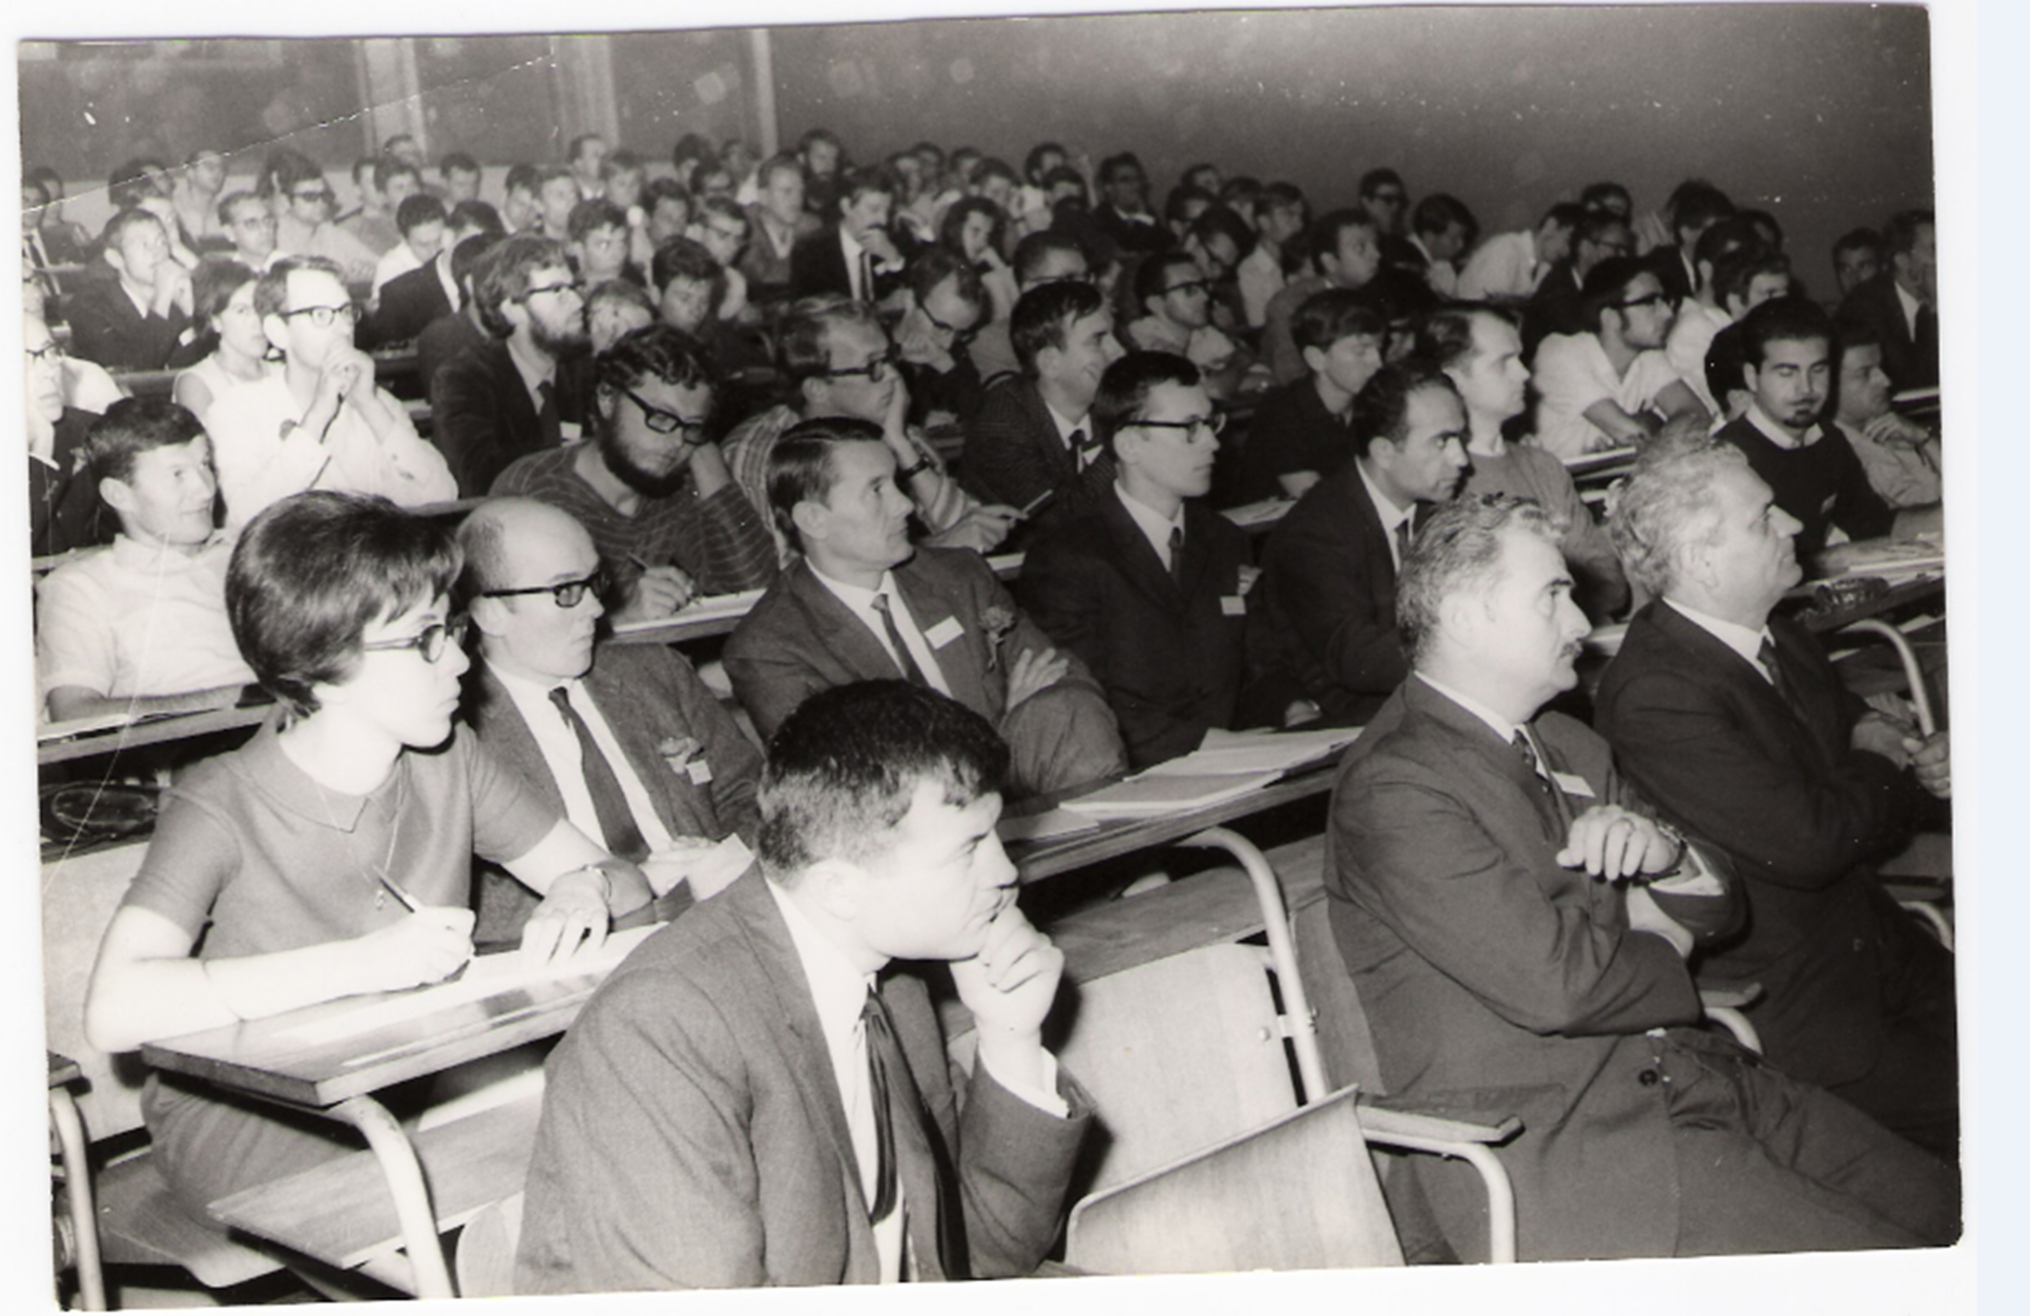
Herceg-novi 68

Slide 3
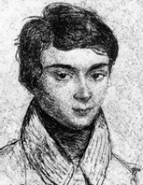
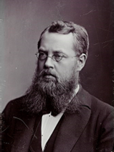
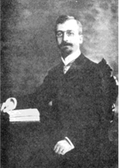
The advent of Group Theory
“The book of Nature is written in the language of mathematics”
Galileo Galilei
“Mathematics is just a question of Groups”
Henri Poincaré
“As far as I can see,
all a priori statements in physics have their origin in symmetry”
Hermann Weyl
“die Grouppenpest”
Wolfgang Paoli
Evariste Galois 1811-1832
Sophius Lie 1842-1899
Elie Cartan
1869 - 1951

Slide 4
A rapid and simplified History
Before the seventies :
SU(3) : eightfold way (1961) , quarks (1964) , coloured quarks (1965) ; QCD (1973)
Poincaré group, Wigner (1939)
BMS group in general relativity (1962)
In the seventies :
(local) Gauge theory …from Yang& Mills(1954); Unification of 3 fundam. forces with SU(3) x SU(2) x U(1)
Supersymmetry…
In the eighties (1984):
2 dim. Conf. Field Theory
String theory
Virasoro algebra, Kac-Moody algebras, Quantum algebras, Elliptic algebras, Super algebras…
Applications in Condensed Matter, Statistical Physics, Integrable Models, Biology (genetic code)
In 2025 :
Generalized symmetries: higher form sym., non invertible sym.,…

Slide 5
Kinematics
de Sitter and anti-de Sitter Groups SO(4,1 ) and SO(3,2)
(R →infinity) ↓ (space - time : 3 +1)
↓
Poincaré group : SO(3,1) » T(4)
(c→O) ↙ ↘ (c→ infinity)
↙ ↘
Carroll group Galilean group
(anti) de Sitter spaces:
max. sym. Lorentzian manifold with constant scalar curvature ˃0 for de Sitter, ˂ 0 for anti de Sitter .
max. sym. vacuum solution of Einstein field equations with cosmological constant Λ ˃0 (de Sitter), Λ˂0 (anti de Sitter)

Slide 6
Metric in the anti de Sitter space (d=4)
ds²= ( 1 + x²/ 4π R²) g^{μν} dx_{μ}dx_{ν} ; g^{μν} = (1,-1,-1,-1)
submanifold of generalized Minkowsky space of 1 more dim.:
ds²= g^{ab} dy_{a}dy_{b} with g^{ab}= (1, 1, -1,-1,-1) for anti de Sitter Sym Group : O(3,2) anti de Sitter
g^{ab}= (1, -1, -1,-1,-1) for de sitter O(4,1) de Sitter
In the limit R → infinity (contraction): Poincaré group
The idea of AdS/CFT :
AdS : boundary around any point looks like Minkowsky space → can be considered as the “space-time” for a CFT.
case of “type II B” string theory on AdS₅x S⁵ : equivalent to N=4 Susy Yang Mills theory on the 4 dim. boundary with Sym. group SO(4,2)
case of M theory: AdS₇x S⁴ (so called (2,0) in 6 dim.) and AdS₄x S⁷ (ABJM, N=6 superconf. in 3 dim)
x_{μ} : stereographic projection coordinates of a 5-dim. pseudo-sphere: R² = g^{ab} y_{a}y_{b}

Slide 7
Null infinity
Asymptotic symmetry group of asymptotic flat Lorentzian space-time at Null infinity:
Null infinity in general relativity: region of null (light-like) geodesics at the boundary of asymptotically flat space time (as the boundary of AdS spaces).
BMS group (Bondi-Metzner-Sachs) :
Lorentz » “Supertranslations”
(infinite dim. abelian group)
[T_{m}, T_{n}] =O m,n Є Z
Recent approaches for extending BMS, for dim.space-time d = 3, 4
Lorentz is replaced by 2 copies of Virasoro algebra.
“Super sym.”case also considered.

Slide 8
Poincaré group : Lorentz group » Translations SO(3,1) » T(4) (c→O) ↙ ↘ (c→ infinity) ↙ ↘ Carroll group Galilean group
[J_{i}, J_{j}] = iε_{ijk} J_{k} [J_{i}, J_{j}] = iε_{ijk} J_{k} [J_{i}, J_{j}] = iε_{ijk} J_{k}
[J_{i}, K_{j}] = iε_{ijk} K_{k} [J_{i}, K_{j}] = iε_{ijk} K_{k} [J_{i}, K_{j}] = iε_{ijk} K_{k}
[K_{i}, K_{j}] = 0 [K_{i}, K_{j}] =-iε_{ijk} J_{k} [K_{i}, K_{j}] =0
[J_{i}, P_{j}] = iε_{ijk} P_{k} [J_{i}, P_{j}] = iε_{ijk} P_{k} [J_{i}, P_{j}] = iε_{ijk} P_{k}
[K_{i}, P_{j}] = iδP₀ [K_{i}, P_{j}] = iδP₀ [K_{i}, P_{j}] = 0
[J_{i}, P₀] = 0 [J_{i}, P₀] = 0 [J_{i}, P₀] = 0
[K_{i}, P₀] = 0 [K_{i}, P₀] =iP_{i} [K_{i}, P₀] =iP_{i}
[P_{i}, P_{j}] = 0 [P_{i}, P_{j}] = 0 [P_{i}, P_{j}] = 0
[P_{i}, P₀] = 0 [P_{i}, P₀] = 0 [P_{i}, P₀] = 0
Carroll Poincaré Galilean
K_{i} → η K_{i} K_{i} → ε K_{i}
P₀→ η P₀ contraction P_{i} →ε P_{i}

Slide 9
Conformal Group SO(4,2) (in d=3+1)
ꓴ
Poincaré Group SO(3,1) » T(4)
*****
Conformal Group SO(4,2) (in d=3+1)
ꓴ
Schrödinger group (in d=2+1)
ꓴ ꓴ
Carroll group Extended Galilean group
[Ki, Pj] = iε M
Schröd. alg. = Gal. alg. + D,C such that {D, C, P0} = SU(1,1)
Relativ. m=0 part in d dim ----mass. part. in (d-1) dim ?
Conformal reminiscence?
BMS (d+2) isomorphic to “Conf.Carroll (d+1)” for d=1,2.
(Kin..Sym. Schröd. equa.)

Slide 10
Dynamics 1
In the sixties:
SU(3) group to classify hadrons : “eithtfold way “ Gell-Mann (1961)
Quarks (1964) , Coloured quarks (1965), QCD (1973) ….
In the seventies: Gauge theory: local gauge invariance
“We define isotopic gauge as an arbitrary way of choosing the orientation of the isotopic spin axes at all space-time points, in analogy with the electromagnetic gauge…” Yang & Mills (1954)
Electrodynamics invariant by minimal coupling: U(1) symmetry:
Define D_{μ} = ( ∂_{μ} –iq e A_{μ} ) covariant derivative
( ∂_{μ} –iq e A_{μ} ) Φ(x) → ( ∂_{μ} –iq e A’_{μ} ) Φ’(x) with : A’_{μ} (x) = -1/e ∂_{μ} θ (x) + A_{μ}(x)
Generalisation : G symmetry with gener. { X1, …, Xn}
Φ (x) → Φ’ (x) = exp {-i q X_{i} θ^{i} (x)} Φ (x) = U(θ) Φ (x)
Covariant derivative: D_{μ} = ( ∂_{μ} –ig X_{i} A^{i}_{μ})
D_{μ} Φ (x) → exp {-i q X_{i} θ^{i} (x)} D_{μ} Φ (x) = D’_{μ} Φ’ (x) with : X_{i} A^{i}_{μ} → U(θ) [X_{i} A^{i}_{μ} -i/g U(θ)⁻¹∂_{μ}U(θ)] U(θ)⁻¹

Slide 11
STANDARD MODEL of Strong,Weak and Electromagnetic inter.
SU(3) x SU(2) X U(1)
Quarks and Leptons as well as interm. Vector Bosons in repres. of G
UNIFICATION of the three forces → Grand unification SU(5) ,SO(10) …even attempts with exceptional groups…
Including gravity??? → String theories….
*****
SUPERSYMMETRY:
Adding to Poincaré spinors (1/2,0) and (0,1/2) under Lorentz : { Ǫ_{α} , Ǭ^{β}} = 2 σ^{μ}_{αβ} P^{μ} I=1,⋯,N.
and Extended Supersym. Ǫ_{α}^{A} , Ǭ_{β}^{A} (with A=1,…,N) transforming under some “internal” sym. group.
Minimal (N=1) Supersym. Standard Model
N=4 AdS/CFT correspondence of Maldacena and its application to correlation functions in the the conformal phase of N=4 Super Yang Mills
Math: Kac’s classification of simple superalgebras , in analogy with Cartan classif. of Simple Lie algebras.
SU(n), SO(n), Sp(n) , Exc. Alg. → SU(m, n) , Osp(m,n) , Exc. Super Alg.

Slide 12
Dynamics 2
The advent of 2 dim.CFT (1984)
“Global” conformal group in 1+1 dim: SO(2,2) = SO(2,1) + SO(2,1)
Any analytic mapping of the complex plane onto itself is conformal
Stress energy tensor T(z, z⁻) of a CFT → 2 copies of Virasoro alg. : L_{m}= -z^{m+1}d/dz
[L_{m ,} L_{n} ] = (m-n) L _{n+m} + (c/12) m (m²-1) δ_{m+n, 0} c central charge
[L’_{m ,} L’_{n} ] = (m-n) L’ _{n+m} + (c/12) m(m²-1) δ_{m+n, 0} with [L_{m ,} L’_{n} ] = 0
BPZ idea
a) Local operators φ_{i}(x) in representations of Virasoro algebra
b) constituting an associative algebra : φ_{i}(x)φ_{j} (y) = C_{ij}^{k} (x-y) φ_{k} (y)
→ ”minimal models” identified with 2 dim. Statistical Models at critical points

Slide 13
Applications in String Theory
worldsheet is 2 dim. and string action invariant under conf.transf.
string scattering amplitude expressed in terms of correlation functions of a CFT defined on the plane (tree amplitudes), on the torus (one-loop amplitudes)…
Actually CFT developed along other directions in mathematics and physics.
Kac-Moody algebras (KM) : G(S¹) Affine Algebras
C (z, z⁻¹) x G with |z|=1 and G simple
z^{m} x T_{a} = T^{m}_{a} (mЄ Z) [T_{a}, T_{b}] ) = if _{ab}^{c} T_{c}
[T^{m}_{a}, T^{n}_{b}] ) = if _{ab}^{c} T_{c}^{m+n} - k/2 m δ^{m+n} ˂ T_{a} , T_{b} ˃ e
[e, T^{m}_{a}] = 0

Slide 14
Semi-direct product: Vir. » G(S¹)
from algebra of vector fields V(S1) L_{m} = -z^{m+1} d/dz
by Sugawara construction:
using a Fock space s.t. T^{m}_{a}|0˃ = 0 if m˃0, and a normal ordering :
L_{m} = ∑^{dim G}_{a=1} ∑_{mЄZ} : T^{m}_{a} T^{n-m}_{a} :
→ [L_{m ,} L_{n} ] = (m-n) L _{n+m} + (c/12) m(m²-1) δ_{m+n, 0}
→ [L_{m}, T ^{n}_{a}] = -n T_{a}^{m+n} with: L_{m}= -z^{m}
Super Vir.algebra: or N=1 Super Conf. Alg.
Adding to T(z) of conformal spin 2 a conf. fermionic spin 3/2
G(z) = z^{-3/2 –r} G_{r} with r Є Z (Ramond sector) or r Є Z +1/2 (Neveu –Schwarz sector)
→ [L_{m ,} G_{r} ] = (1/2 m - r) G_{m+r}
→ {G_{r} , G_{s} } = 2 L_{r+s} + c/3 (r²- 1) δ_{r+s,}

Slide 15
W algebras: generalisation of Vir. alg, symm. of Integrable models:
with a stress energy tensor T as well as a finite number of primary fields W_{hi} (i=1,…,n-1) under T satisfying:
{T(z) , T(w) }_{PB} = -2 T(w) δ’ (z-w) + მ T(w) δ(z-w) + c/2 δ’’’ (z-w)
{T(z) , W_{hi}(w) }_{PB} = -h_{i} W_{hi}(w) δ’ (z-w) + მ W_{hi}(w) δ (z-w)
{W_{hi}(z) , W_{hj}(w) }_{PB} = ∑_{a} P_{i,j;a}(w) δ^{(a)} (z-w)
with P_{i,j;a}(w): polynomials in W_{hj} , T and their derivatives.
- Toda field theories associated with simple G: both integrable and conform. invariant, their constants of motion form a Wn algebra. Seen as gauged WZW models with constraints, construction of different W algebras for a given G.
- Generalisation to the supersymm. case.

Slide 16
Quantum Groups: Uq(G)
deformation of enveloping alg. of G:
Ex: U_{q}(Sl(2)) [J₊, J₋] = (q^{2J}₃ - q^{-2J}₃ ) / (q - q⁻¹)
[J₃, J₊] = + J₊
q=1 ↙ ↘ q=0
[J₊, J₋] = 2J₃ can be defined [J₃, J₊] = +J₊
[J₃, J₋ ] = - J₋ called ‘’Crystal basis’’ repres.
Application : Sym. of Quantum Heisenberg model “XXZ” (deformation of “XXX” model”) is U_{q} (affine Sl(2)), a useful property for its integrability.
Generalisation:
Super Kac-Moody alg, Super Virasoro, Super W alg, Super Quantum groups…
Quantum affine Uq( affine G).
Algebras with 2 deform.parameters: Ap,q(affine G) and Bp,q (arising from Yang-Baxter equation)
Various extensions of Kac-Moody defined on a manifold M of dim ˃1 and a Grassmann alg of dim N ˃1.
Application of Quantum Group in the limit q→0 to Genetic Code

Slide 17
An application of Quantum groups : a model for the Genetic code
U_{q}(Sl(2)) deformation of enveloping alg. (space of polyn. and power series in elements) of Sl(2) !
[J₊, J₋] = (q^{2J}₃ - q^{-2J}₃ ) / (q - q⁻¹)
[J₃, J₊] = + J₊
↙ ↘
q=1 q=0
[J₊, J₋] = 2J₃ can be defined [J₃, J₊] = +J₊
[J₃, J₋ ] = - J₋ called ‘’Crystal basis” repres.

Slide 18
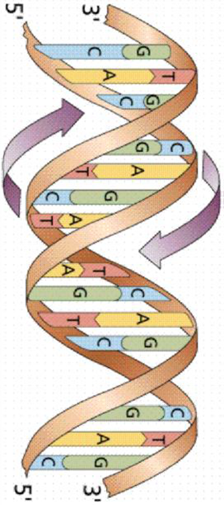
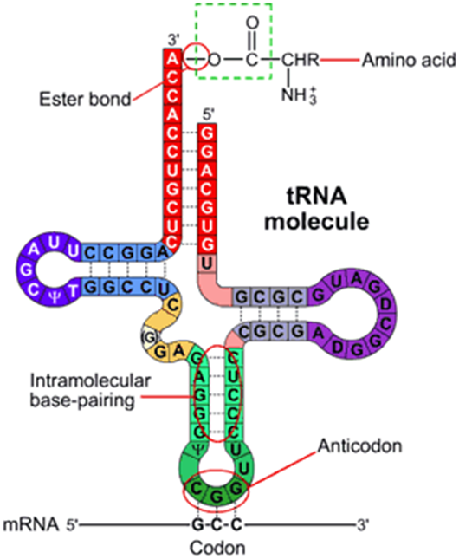
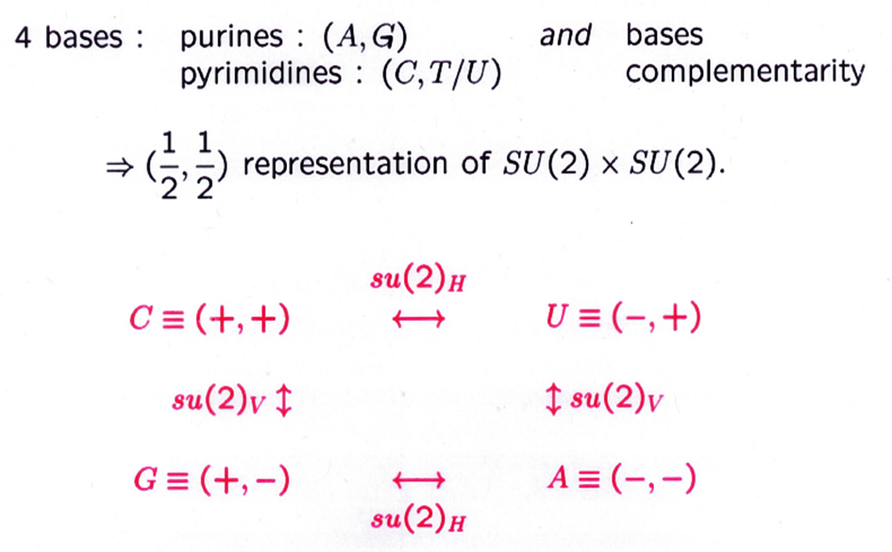
CRYSTAL BASIS MODEL FOR THE GENETIC CODE

Slide 19
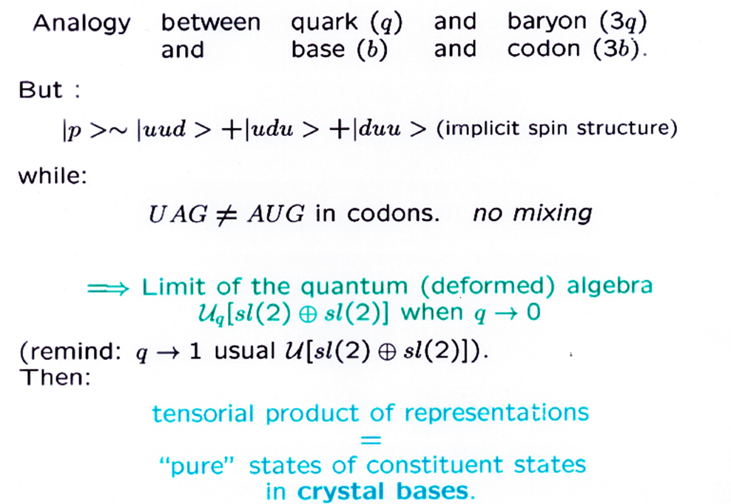
Many applications: sum rules for codon usage probabilities, some predictions between physical-chemical properties of amino-acids, evolution of the genetic code, interaction between codon-anticodon
for a review: A.Sciarrino and P.Sorba, arXiv: 1704.00940 [qbio.OT]

Slide 20
Generalized symmetries
Notion of symmetry broadened in different directions:
higher form sym. , non-invertible sym., fractal sym. , and others.
An example of non –invertible symmetry:
Fusion rules in CFT: critical Ising model
Φ₁ and Φ₂, primary fields, i.e. highest weights of a Virasoro repres.
Fusion of Φ₁ Φ₂ = fields created by their short distance product .
Fusion of Φ₁ Φ_{2 ≠} into Φ₃ is possible if 3 point function ˂Φ₁ Φ₂ Φ₃˃ ≠0 (related to the presence of “null vectors” in the Virasoro repres.)
In Ising model: 3 local scaling operators identified with minimal model : c=1/2 h= 0 h= 1/16 h= 1/2
Identity I Ising spin Density energy ε
Satisfying fusion rules σ x σ = I + ε σ x ε = σ ε x ε = I
This algebra is isomorphic to the algebra { D, η , I } of global sym. of Ising model:
D x D = I + η D x η = D η x η = 1
σ (or D) non invertible

Slide 21
As a conclusion
« Soon, without doubt, abstract Physics will order all the possibilities of experiment »
Gaston Bachelard, La Formation de l’esprit scientifique
… with the help of group theory ?
Thank you for your kind attention

