Slide 1
Inhomogeneous SO(3) Spin Chain with periodic boundary conditions
Igor Salom (Institute of Physics, Belgrade)
and Nenad Manojlovic (University of Algarve, Portugal)

Slide 2
Talk outline
Introduction to algebraic Bethe ansatz
A few words on motivation
Define XXX chain problem
Introduce standard notions (R matrices, Lax operator, monodromy, transfer matrix, Bethe equations)
Solving ABA
S0 (3) chain
R matrix
Solving ABA

Slide 3
Motivation?
So few problems that we can exactly solve
Any such is precious
The more general, the better
Some models have more or less natural potential application
Explains dominant magnetic behavior
Related to conformal field theories in 2 dimensions
Expected to provide insights to realistic problems
Gaudin model – integrable with long range interactions

Slide 4
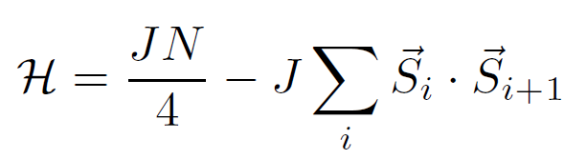
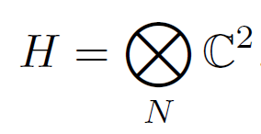
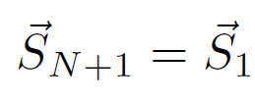
Basic problem – spin chain
Heisenberg spin chain Hamiltonian (nearest neighbor interaction):
Solve = find energies, wave functions, other conserved quantities

Slide 5
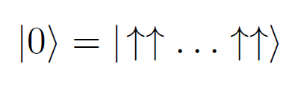

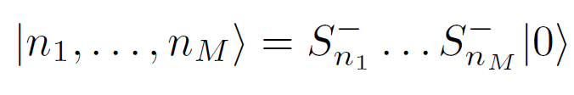
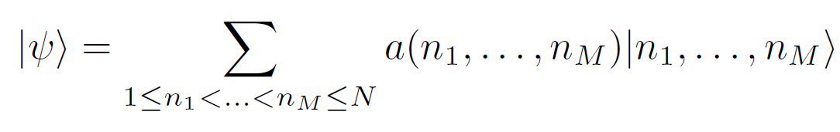
Coordinate Bethe ansatz
90 years old approach:
Does solve the main problem, but not allowing easy generalizations
We will not follow this approach

Slide 6


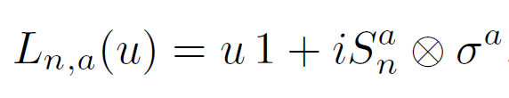


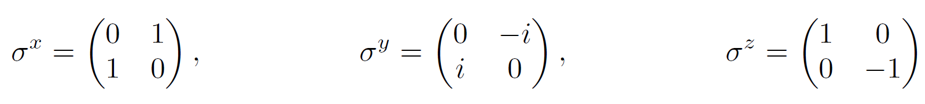
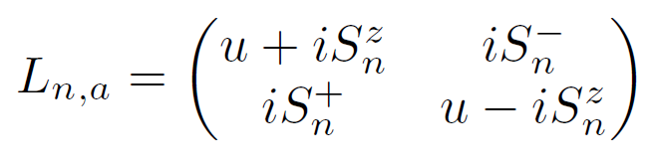
Algebraic Bethe Ansatz (ABA)
Introduce additional auxiliary space and a “Lax operator”:

Slide 7

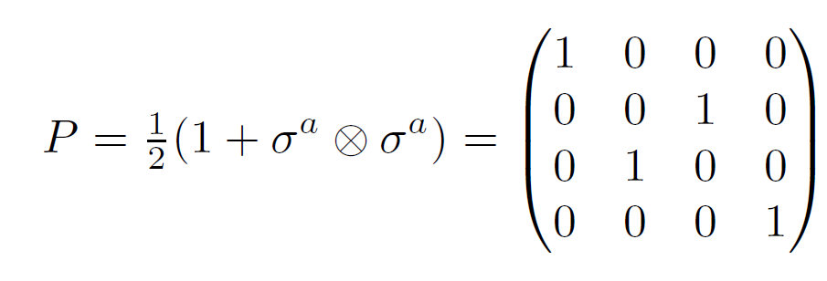

Relation to permutation operator
Lax operator can be written as:
Where P is permutation operator:

Slide 8

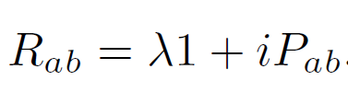
How do Lax operators commute?
Consider:
where:
This “RLL” relation or “fundamental commutation relation” can here be confirmed by using:
?

Slide 9
R matrices
These R matrices satisfy the (quantum) Yang-Baxter equation:
Which can be seen to follow from RLL relation, since:
while also:

Slide 10

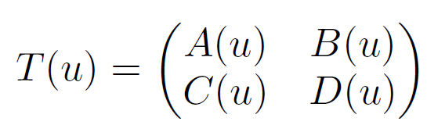
Monodromy
Now we define “Monodromy”, that acts on the entire chain:
That can be seen as a 2x2 matrix whose elements are operators on the basic Hilbert space:
From RLL we find how T-s commute, i.e. RTT:

Slide 11


Transfer matrix
The trace:
due to
commutes for different values of the parameter:

Slide 12
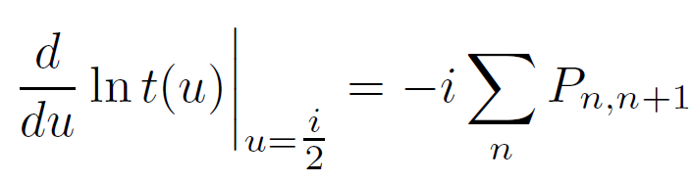
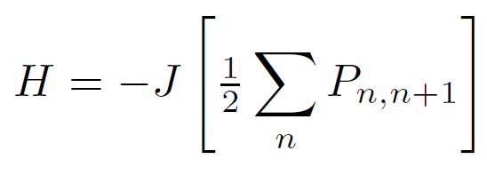
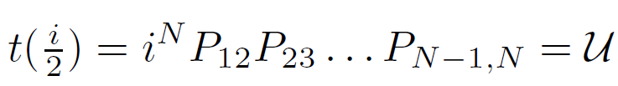

Why is this important?
We have families of mutually commuting operators, e.g. obtained from power series expansion. And one of such operators is the Hamiltonian! From:
one obtains:
which is proportional to the Hamiltonian:
also:

Slide 13
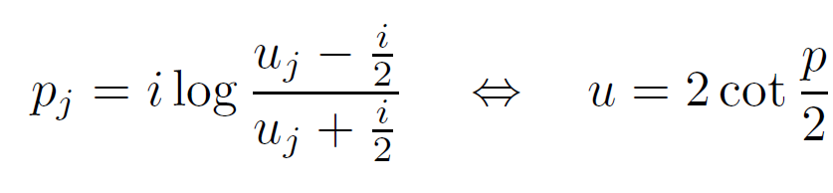
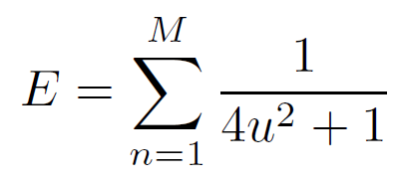
Connection with physical entities
Rapidities u_{i} are related to momenta of “magnons”
And the formula for energy:

Slide 14
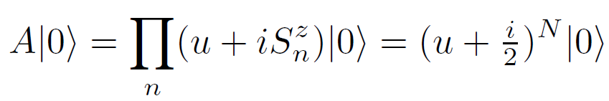


Solving the transfer matrix eigenproblem
If we know eigenvalues of the transfer matrix t(u), we know values of all conserved quantities!
First we show that is an eigenstate:
thus:
also we note:

Slide 15
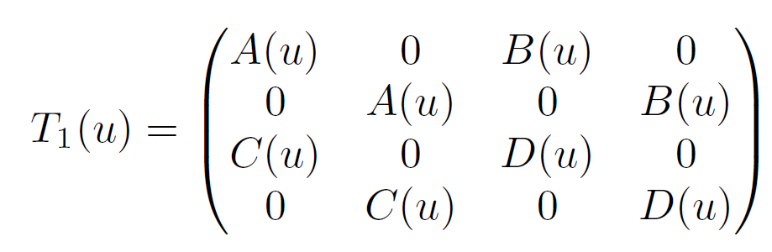
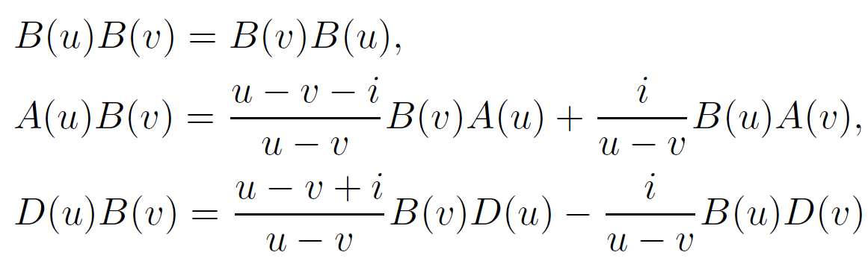
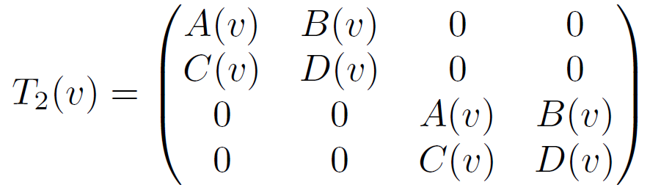
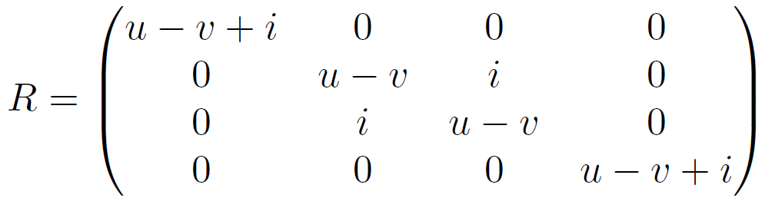
The rest of eigenvectors?
We show that these are obtained by action of B operators.
First we need “commutation” relations:

Slide 16


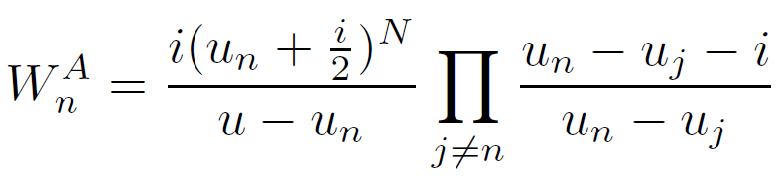
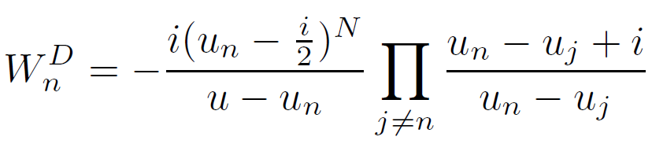
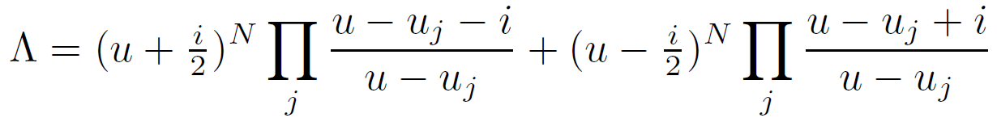
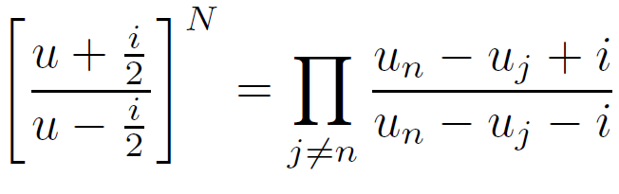
From the commutation relations…
If we define vectors:
we obtain “off-shell” action:
unwanted terms
= 0
eigenvalue
Bethe equations

Slide 17

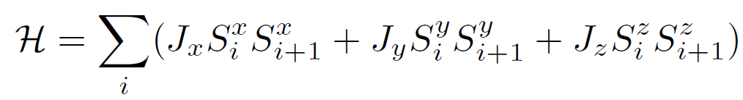

Research generalizations
Inhomogeneous chain:
Interaction does not have to be isotropic
Arbitrary spin
Nonperiodic, more general boundary conditions
Extension to long range interaction (Gaudin model)
and...
XXZ chain
XYZ chain

Slide 18


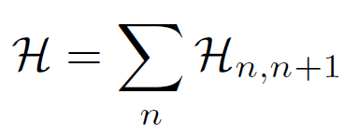
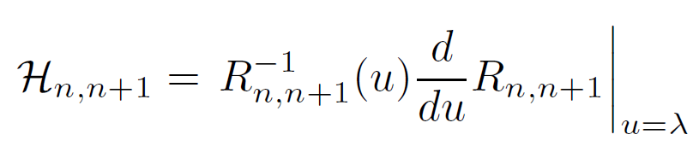



...take different R!
Each R matrix satisfying Yang-Baxter equation defines an integrable spin chain!
If and
It is proved following the same procedure:
Yet, it is not easy to solve the t eigenproblem

Slide 19
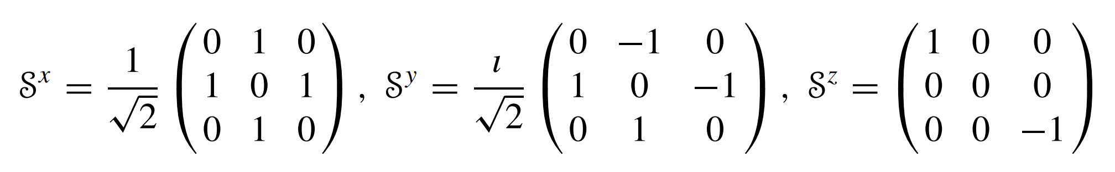
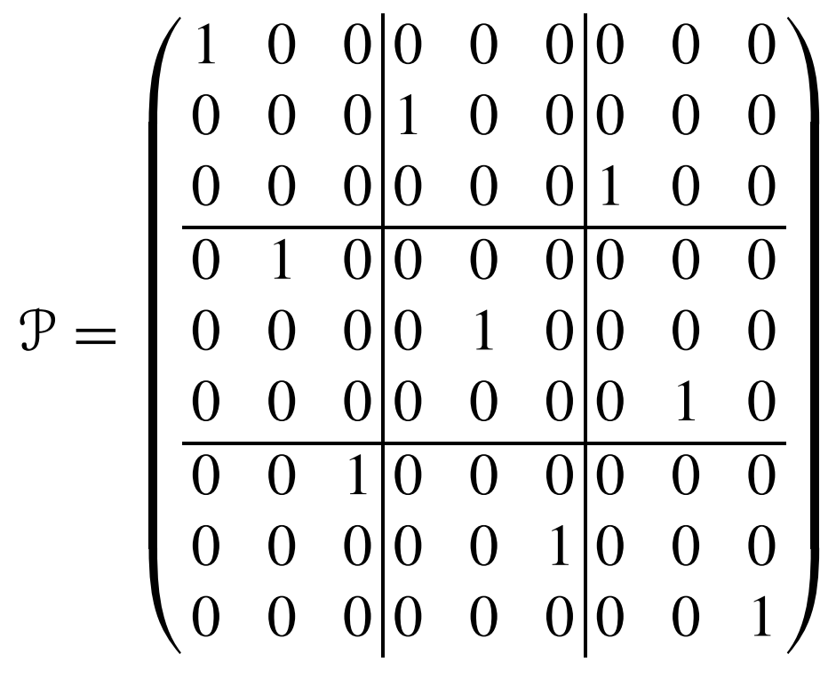
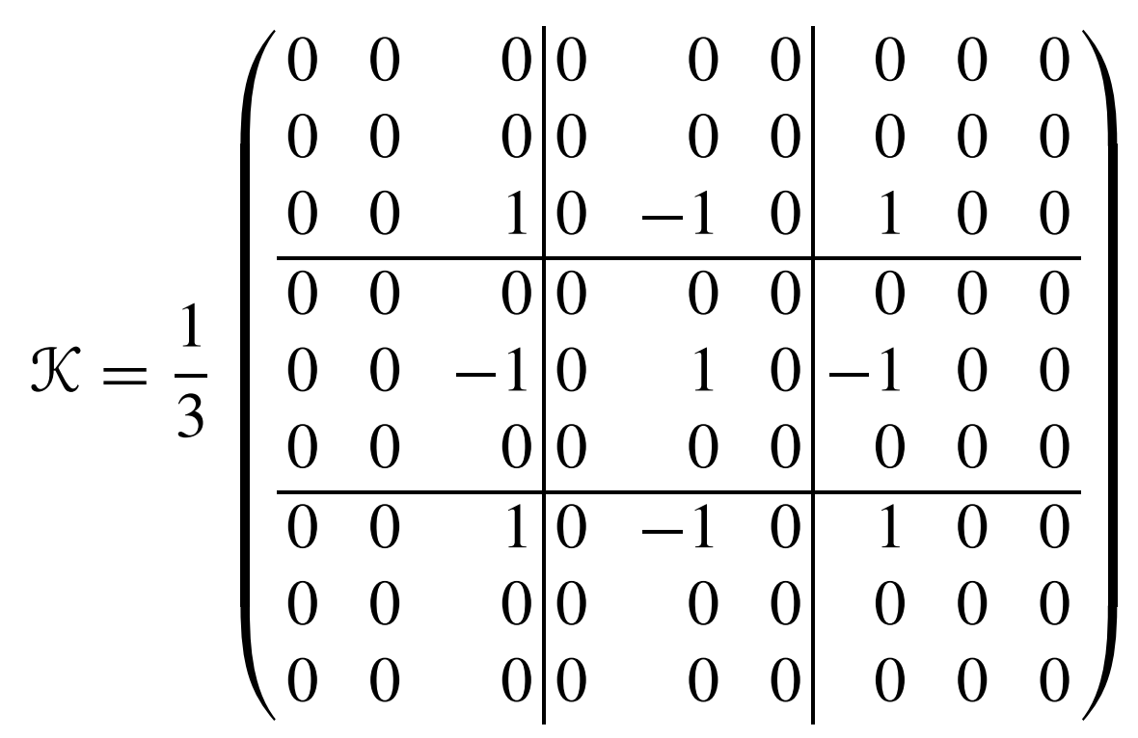

SO(3) chain
Generators:
3 invariant ops. in tensor product space: I, P and K

Slide 20
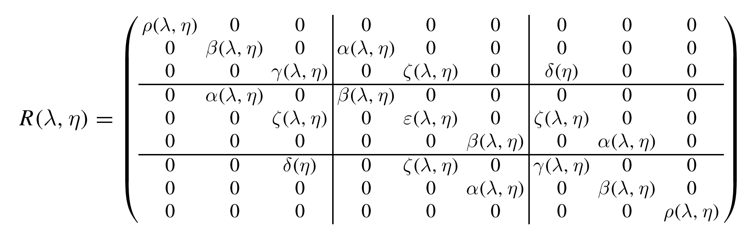
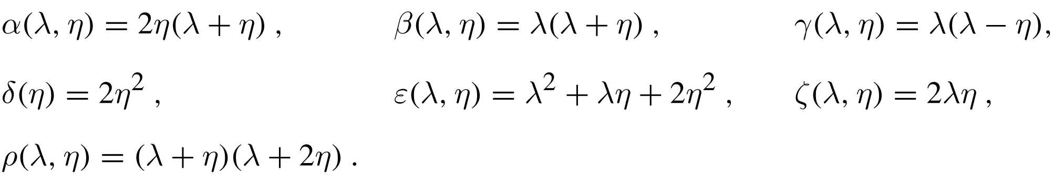

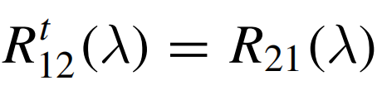
SO(3) invariant R matrix

Slide 21
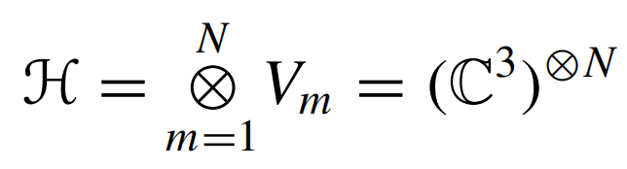
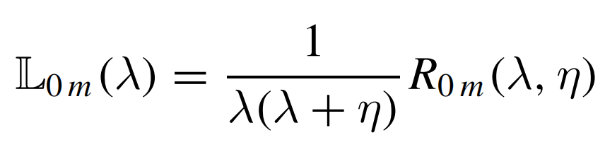
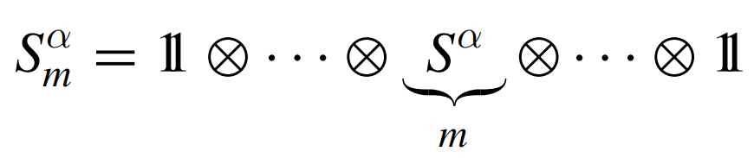
Lax matrix
Physical Hilbert space:
Lax operator - 3x3 matrix
with entries functions of “local” spin operators:
Yang-Baxter implies RLL:

Slide 22
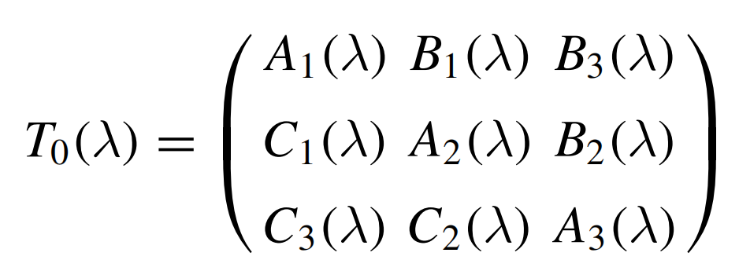


Monodromy and transfer matrix
Monodromy with inhomogeneous parameters:
Entries are operators acting in the physical H.s.:
RTT:
So that:

Slide 23
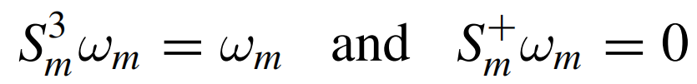

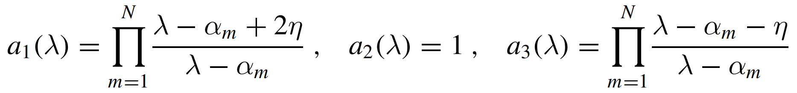
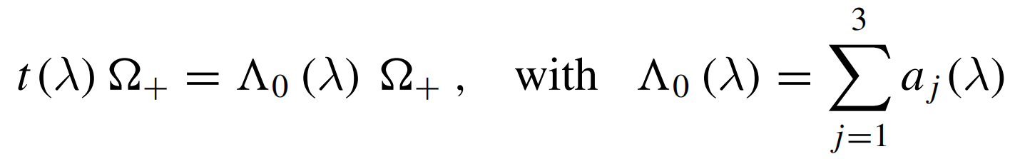
Vacuum state
At each node we chose h.w.v.:
and the overall h.w.v.:
From the local realization of monodromy entries:
so that:

Slide 24
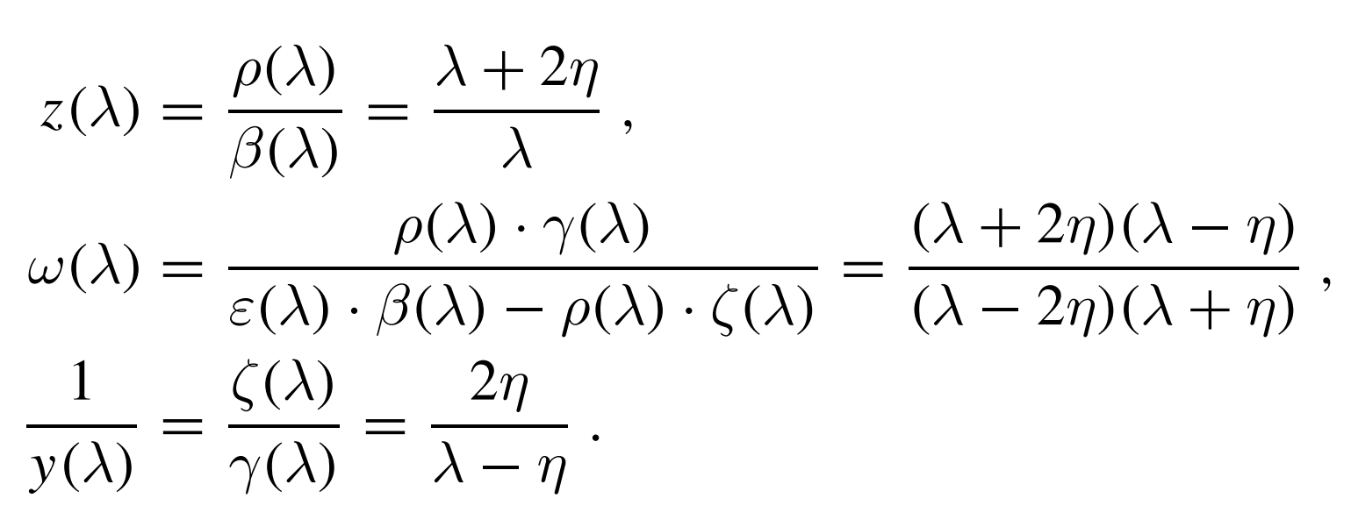
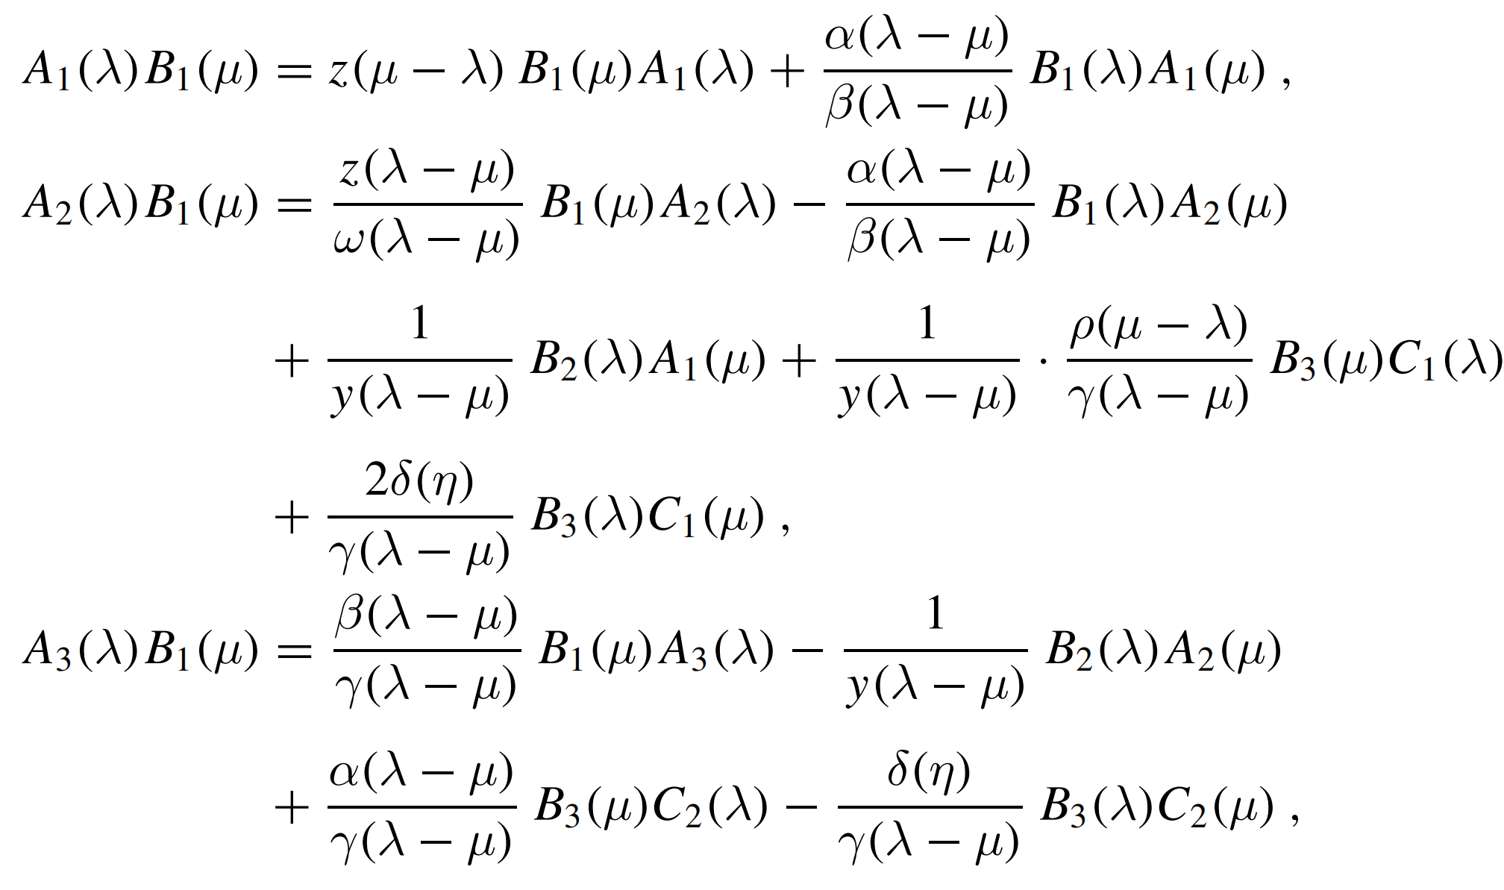
ABA algebra (part 1)
Where:
From RTT:

Slide 25
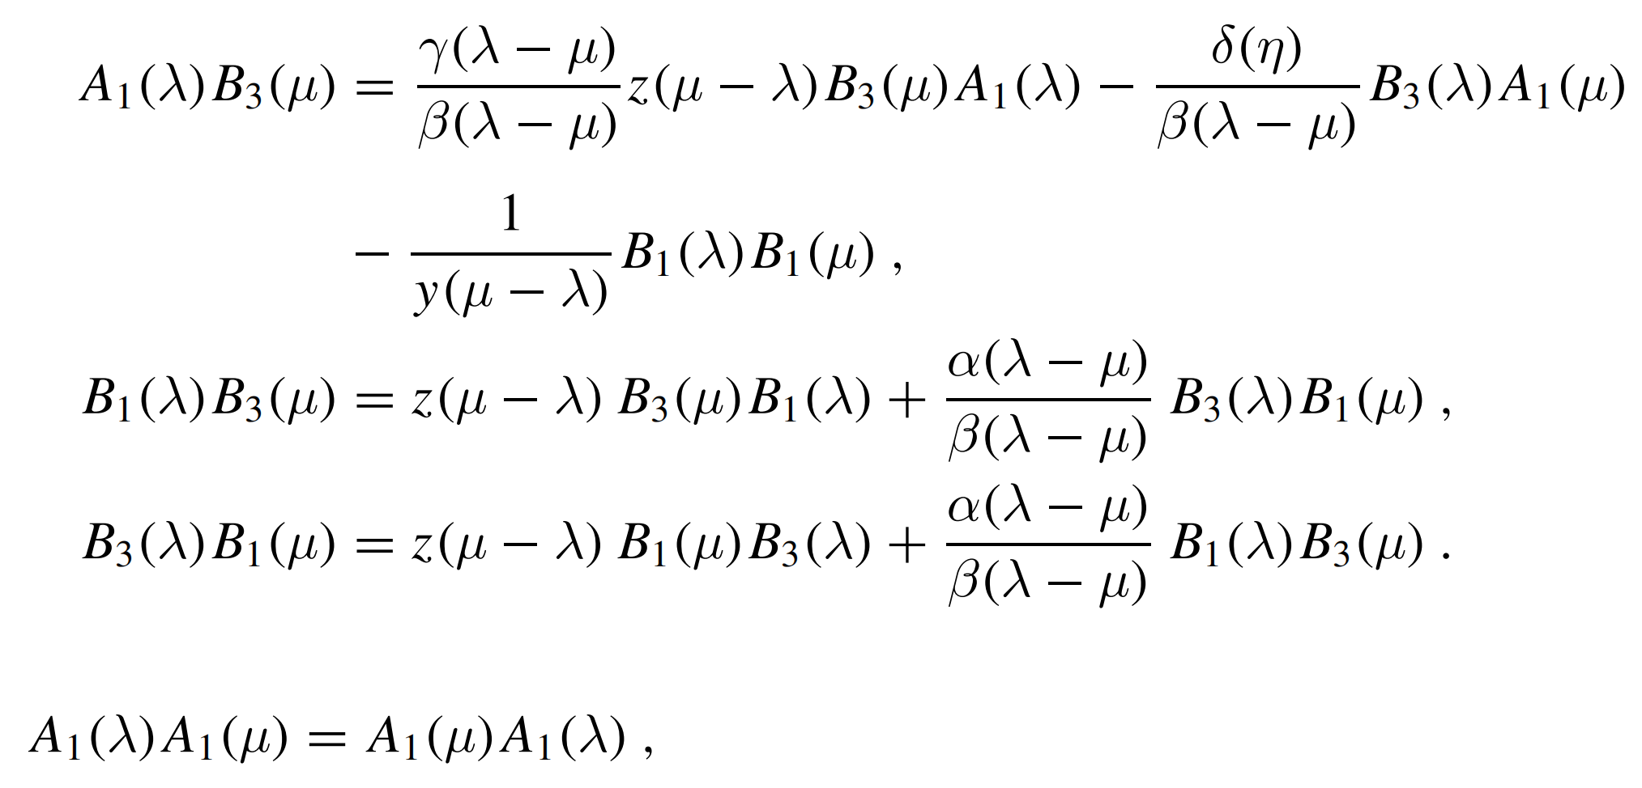
ABA algebra (part 2)
Also from RTT:

Slide 26
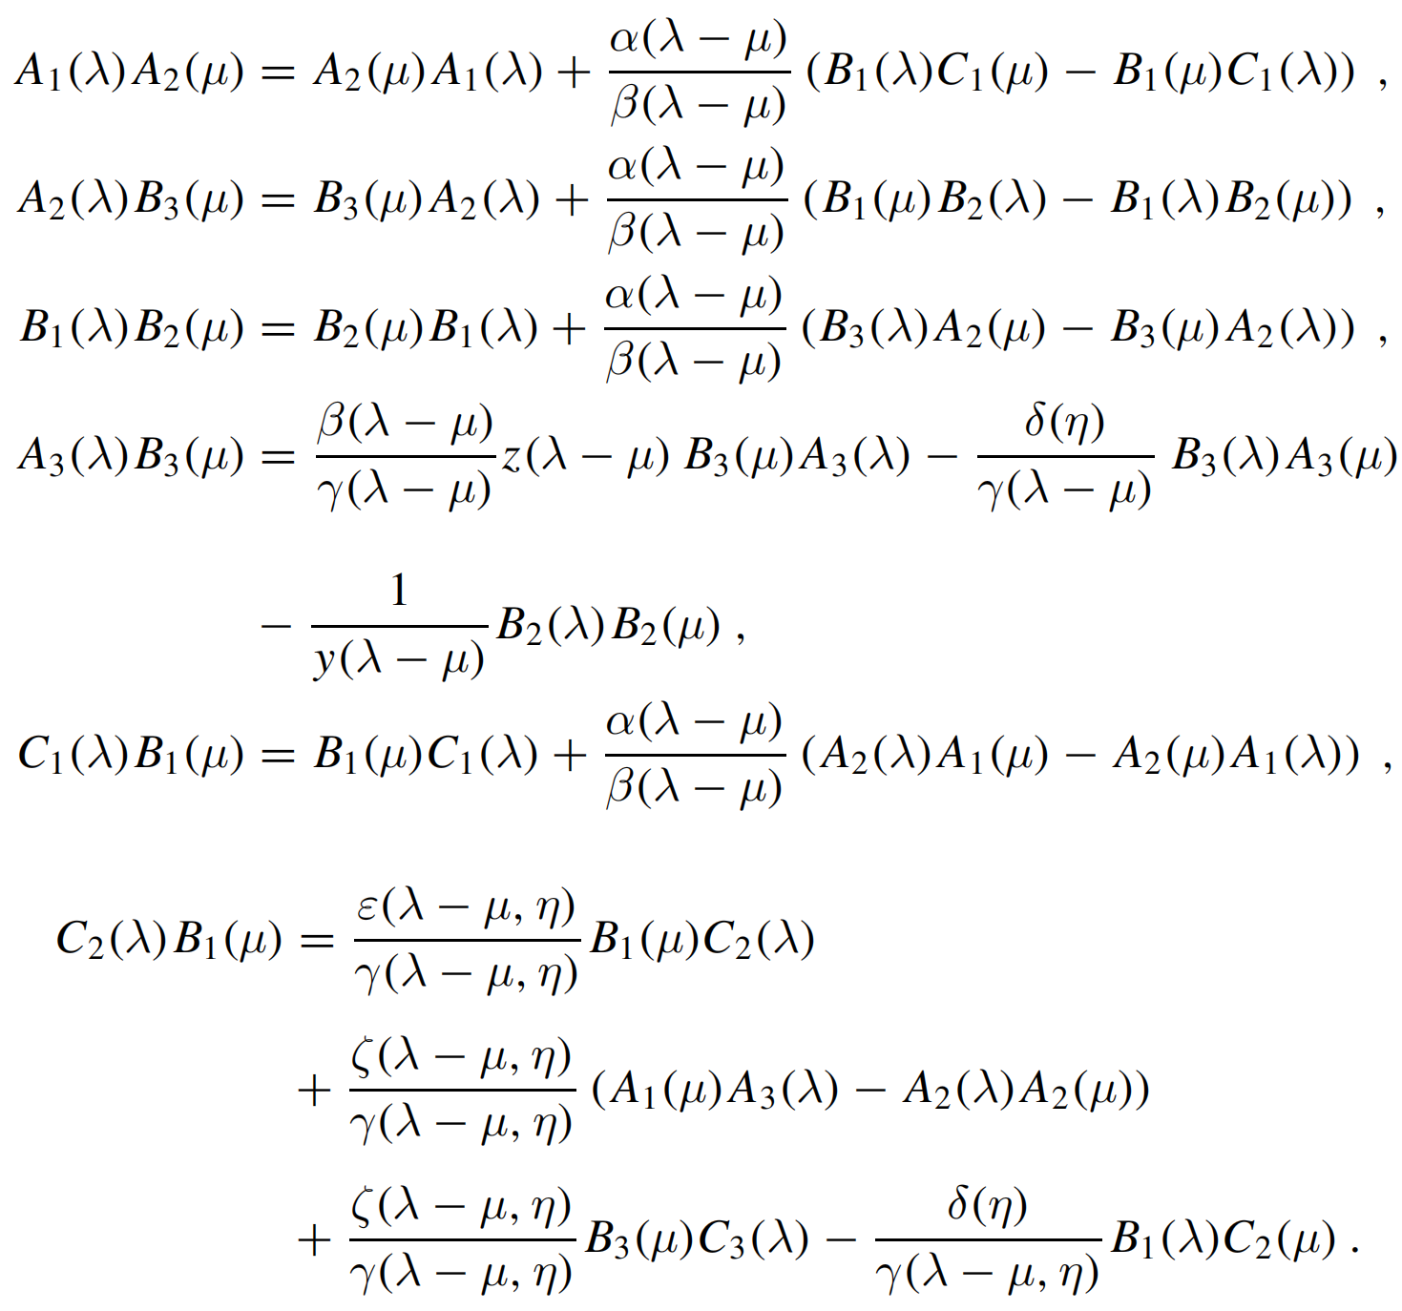
ABA algebra (part 3)
Also from RTT...

Slide 27
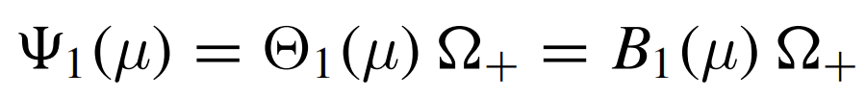
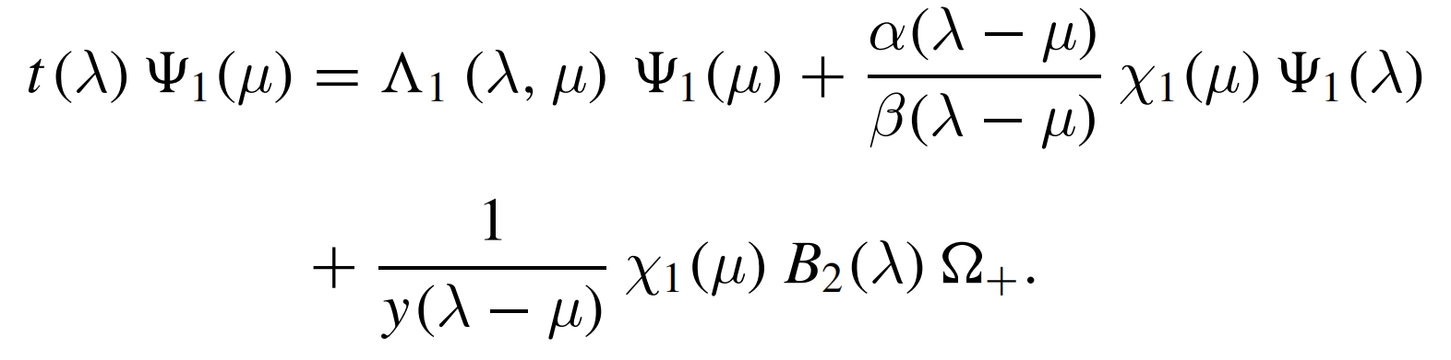
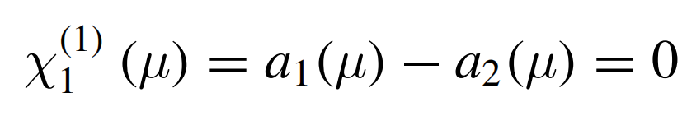
Single excitation
Using algebra relations we show that
satisfies:
with eigenvalue:
and Bethe equation:

Slide 28
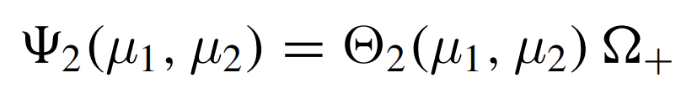



Two excitations
Define:
where:
with property:
so that...
things get complicated...

Slide 29



Two excitations

Slide 30



General solution
define:
so that:

Slide 31





...where:
eigenvalue:
unwanted terms:
Bethe equations:

Slide 32
Summary
We have ilustrated:
ABA construction (Heisenberg chain)
How quickly things get more complicated
In particular, shown reccurent relations for Bethe vectors in SO(3) case

Slide 33
Thank you.

Slide 34




XXZ chain (trigonometric case)
R matrix
Arbitrary spin:
U_{q}(sl(2))
generators

Slide 35


After a few usual steps&relations…

Slide 36

Introducing nontrivial boundary conditions
Introduce 2x2 matrices K⁺ and K⁻ that parameterize boundary conditions
Following Sklyanin, these must satisfy “reflection” equations:

Slide 37



New monodromy matrix
It incorporates boundary conditions:
where:
satisfying

Slide 38

Transfer matrix
The transfer matrix is now constructed as:
and corresponds to Hamiltonian:
introduces huge complications
nontrivial boundary terms

Slide 39





Commutation relations
From:
we find:

Slide 40





Finding Bethe vectors: vacuum
Start with vacuum:
where and we set φ=0
Method to get other eigenstates (i.e. excitations): act with operators on vacuum!

Slide 41




First order excitation
One magnon excitation vector:
eigenvalue
unwanted terms
Bethe equations

Slide 42

However, there is a freedom…
Due to the following relation:
There is actually a whole class of solutions, satisfying identical off-shell equation:
This is a generic feature, we don’t know it was discussed before!

Slide 43





Second order excitation
One of intermediary steps

Slide 44



It satisfies off-shell equation:

Slide 45


But also does:
which is a consequence of identities:

Slide 46


General solution

Slide 47

…

Slide 48




Off shell action:
I.e., the inhomogeneous XXZ spin chain with nonperiodic b.c. and arbitrary spins is solved!

Slide 49
Conclusion so far
We illustrated the ABA method
Following that approach, we have solved a spin-chain model with inhomogeneity, anisotropy and non-periodic boundary condition
We pointed out the degrees of freedom that appear in off-shell solutions
We set up the stage to derive another model, of long range interactions – Gaudin model…

Slide 50


Gaudin model
It turns out that we can obtain a related integrable model by considering expansion series (in “eta”):
“Classical” Yang-Baxter
Yang-Baxter

Slide 51



Chain to Gaudin connection
Lax operator:

Slide 52


Chain to Gaudin connection
Monodromy and transfer matrix
This does not lead to nice/useful expressions…

Slide 53




We correct it by a trick…
There is a central element:
We redefine transfer matrix:

Slide 54


Long range Hamiltonians
New transfer matrix can be written as:
where Hamiltonians we choose as the residues at poles:
long range, not merely nearest neighbors!

Slide 55






Non-periodic boundary
In a long and painful procedure, we can repeat everything with nontrivial “boundary” conditions:
…
…
…

Slide 56




New, more general Hamiltonians
Again obtained as residues…
nontrivial boundary terms

Slide 57





Similarly for XXZ Gaudin
Expansion in eta (skipping some details):
Now that:

Slide 58


XXZ Gaudin Hamiltonians
It turns out that we can proceed from here to solve some long range interaction Hamiltonians (“Gaudin”):
Additional richness originating from boundary terms
“long range” interaction

Slide 59




i) Solving the eigenproblem using the spin chain Bethe vectors
We may expand previously obtained Bethe vectors:
and find off-shell equations:

Slide 60




…where:

Slide 61





ii) Solving the Gaudin model independently
“Classical” equivalents:
r matrix
satisfying classical Yang-Baxter equation
Gaudin Lax matrix
Obeying Sklyanin linear bracket relation (equivalent of RLL):

Slide 62





Reflection matrix related steps
Introduce:
satisfying:
then:
and:
so that:

Slide 63


Commutation relations
Denoting:
With φ=0 we find:

Slide 64




Change of variables

Slide 65



We find the eigenvectors in terms of the new operators:
Introduce a class of creation operators:
then we can write solutions as:

Slide 66
Summary
We have shown:
ABA construction
How to include nontrivial b.c. in a spin chain
How to get Gaudin as the limit (expansion)
How to include nontrivial b.c. in Gaudin
Proper operators lead to solution of Gaudin ABA

Slide 68



Solving = Algebraic Bethe Ansatz
similar idea as before…
Horrible relations…

Slide 69


…how to simplify them?
After the second attempt to find (E,F,H) → (e,f,h):

Slide 70


Now: solution + analytic proof
Bethe vectors:
eigenvalues:
=0 ← Bethe equations

Slide 71

Now we can read energies

Slide 72




Knizhnik–Zamolodchikov equations
By introducing:
we recognize that the new function satisfy equations of Knizhnik–Zamolodchikov form (B. Feigin, E. Frenkel, N. Reshetikhin, Com. Math. Phys. 166 (1994) 27–62):

Slide 73



Scalar product formulas
On shell (i.e. Bethe eqs. satisfied):
Off-shell:

Slide 74
Summary
We have shown:
ABA construction
How to include nontrivial b.c. in a spin chain
How to get Gaudin as the limit (expansion)
How to include nontrivial b.c. in Gaudin
Proper operators lead to solution of Gaudin ABA
Eqs. of KZ form are demonstrated to hold
Demonstrated norm/scalar product formulas

Slide 76
Finding Bethe vectors - vacuum
Start with vacuum:
where and we set φ=0

Slide 77
First order excitation
One magnon excitation vector:
eigenvalue
unwanted terms
Bethe equations

Slide 78
However, there is a freedom…
Due to the following relation:
There is actually a whole class of solutions, satisfying identical off-shell equation:
This is a generic feature, we don’t know it was discussed before!

Slide 79
Second order excitation
One of intermediary steps

Slide 80
It satisfies off-shell equation:

Slide 81
But also does:
which is a consequence of identities:

Slide 82
General solution

Slide 83
…

Slide 84
Off shell action:

Slide 85
Conclusion
We illustrated the ABA method
Following that approach, we have solved a spin-chain model with anisotropy and non-periodic boundary condition
We pointed out the degrees of freedom that appear in off-shell solutions
We set up the stage to derive another model, of long range interactions – Gaudin model…

Slide 86
Commutation relations

Slide 87
Nontrivial boundary conditions
Introduce 2x2 matrices K⁺ and K⁻ that parameterize boundary conditions
Following Sklyanin, these must satisfy “reflection” equations:

Slide 88
Transfer matrix
The transfer matrix is now constructed as:
and corresponds to Hamiltonian:
XXZ anisotropy
nontrivial boundary terms

Slide 89
Transfer matrix
The transfer matrix is now constructed as:
and corresponds to Hamiltonian:
nontrivial boundary terms

Slide 90
Transfer matrix
The transfer matrix is now constructed as:
In principle, we nevertheless follow the same path as before…
introduces huge complications

Slide 91
Talk based on…
I. Salom, N. Manojlović and N. Cirilo António, Nuclear Physics B 939 (2019) 358–371
…which is based on: N. Cirilo António, N. Manojlović, E. Ragoucy, I. Salom, Nucl. Phys. B 893 (2015) 305–331 and N. Cirilo António, N. Manojlović, I. Salom, Nucl. Phys. B 889 (2014) 87–108
Certainly Mathematical physics, but definitely not cosmology, not even gravity
→ Better start from some basics…
It is a school, after all!

