Slide 1
New AI Methods for Simplifying Multi-Omics Data Analyses in Precision Medicine
Nataša Pržulj
Professor
Computational Biology
MBZUAI
Professor of Computer Science ICREA
University College London Spain
E-mail: Natasa.Przulj@mbzuai.ac.ae

Slide 2


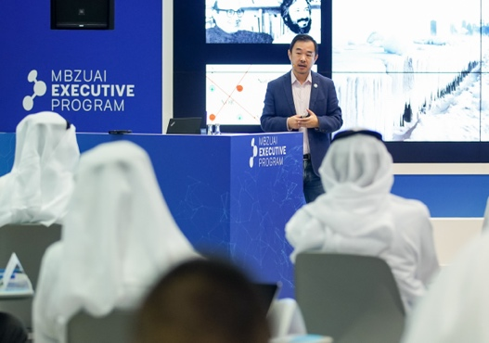



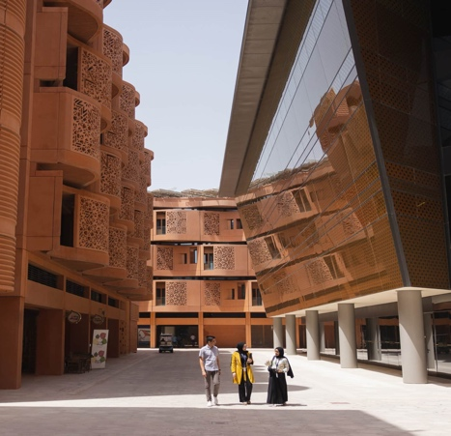

Established in 2019
Public research university
Dedicated to advancing AI, research and innovation
Abu Dhabi, UAE
9th on CSRankings globally in:
AI,
CV,
ML,
NLP,
Robotics,
Computational Biology
1st in AI in the MENA region

Slide 3
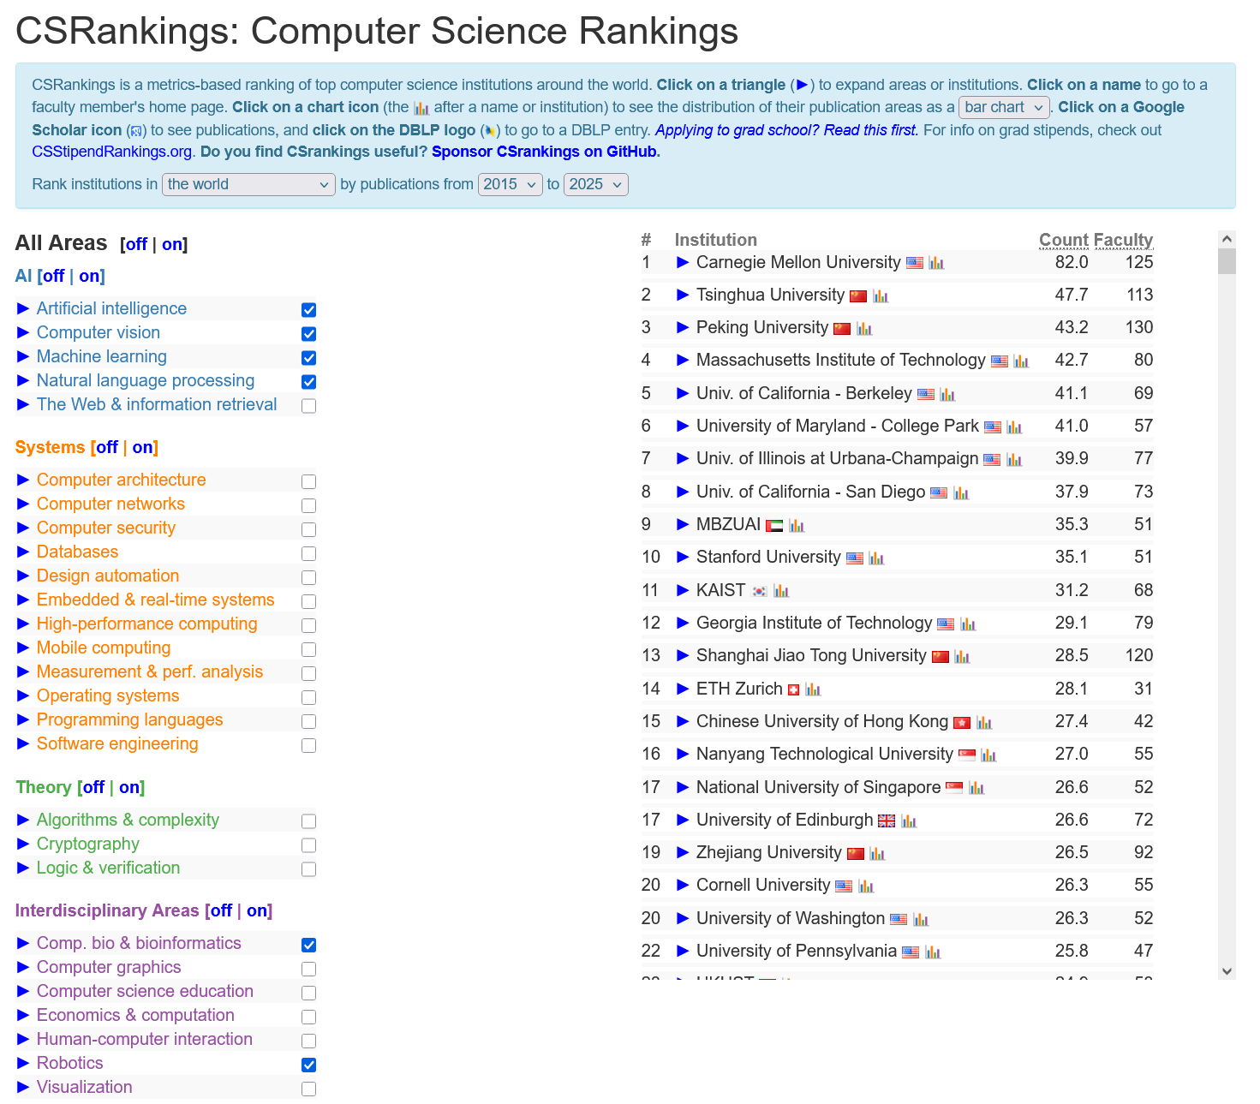

Slide 4























The Epicenter of the “Abu Dhabi AI District”
Future Silicon Valley of the Middle East
Free zone, no tax
v

Slide 5


Our Objective
To become a pre-eminent global institution that revolutionizes education, drives research innovation, and shapes the global technology landscape
– a “Stanford” of the Middle East

Slide 6





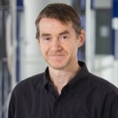












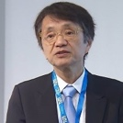
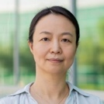






Attracting The Best Brains From The World
Renowned Faculty (Selection)
Eric Xing
President
Timothy Baldwin
Provost
Sami Haddadin
VP – Research
Steve Liu
Associate VP Research
Michael Jordan
Laureate Professor and Honorary Program Director
Sir Michael Brady
Adjunct Distinguished Professor
Eric Moulines
Adjunct Professor of Machine Learning
Kun Zhang
Acting Department Chair of Machine Learning
Preslav Nakov
Department Chair of NLP
Ian Reid
Department Chair of Computer Vision
Eran Segal
Department Chair of Computational Biology
Elizabeth Churchill
Department Chair of Human-Computer Interaction
Yoshihiko Nakamura
Department Chair of Robotics
Xiaosong Ma
Acting Department Chair of Computer Science
Paper per faculty in top conferences from selected world-class universities; source: CSRankings (2020-2024) with all areas covered
Notes:
Color – involvement (FT with management position, FT, affiliated professor, adjunt professor)
Bar – h-index

Slide 7











A Global University With Local Importance
STUDENTS -- ORIGIN¹
(% of total students, number of students )
DEMOGRAPHICS
(total students)
7%
49
Nationalities
2%
9
North America
24
33%
Europe
119
54%
365
Students in total
2%
8
Sub Saharan Africa
2%
9
South America
Middle East & North Africa
196
~30%
Female students
Asia
4.2:1
Student-to-faculty ratio
2024 Fall Students from Top 50 Universities (Select)
7
¹ As of Fall 2024

Slide 8





Academic Partnership

Slide 9










Industry Collaborations
Compute
Research Collaborations
AI Center of Excellence
Responsible AI Foundation

Slide 10










12
Startups supported by IEC
20+
hosted
180+
Students & researchers enabled
Notes:
Palmside chats bring global insights to local discussions – guests including OpenAI, MSFT, AWS, etc.

Slide 11


Key Opportunities (as of now)
Generative AI and Foundation Models - IFM
AI for Personalized Medicine
AI for Sustainability
Create versatile systems to tackle complex, multi-domain challenges
Accelerate disease control and drug design through multi-scale biological prediction, programming, and simulation
Model climate and energy patterns to optimize resources and conservation

Slide 12










Abu Dhabi Living

Slide 13
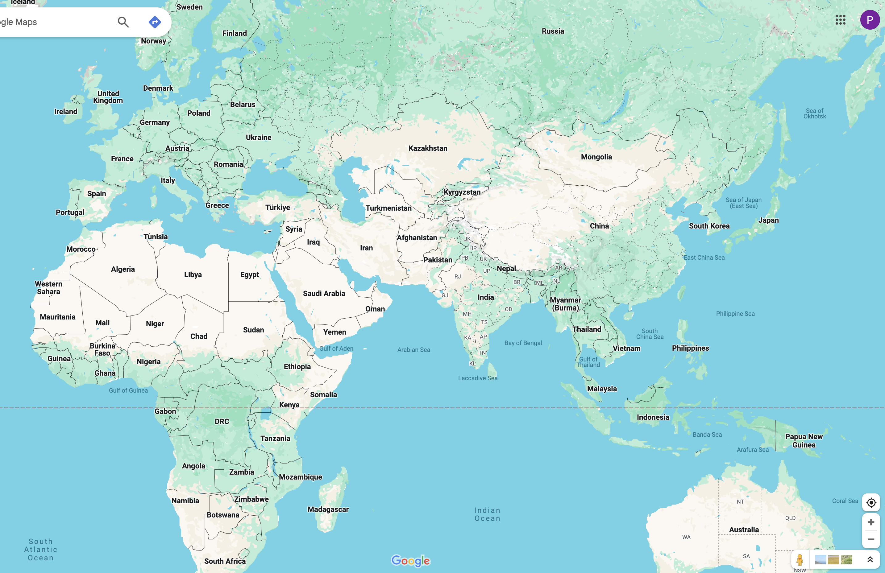
Location
80% world’s population in 8hrs
London 7hrs
Milan 6hrs
Beijing 7hrs
Bangalore 4hrs
Maldives 4hrs
Cape Town 8hrs

Slide 14





Abu Dhabi Sport

Slide 15
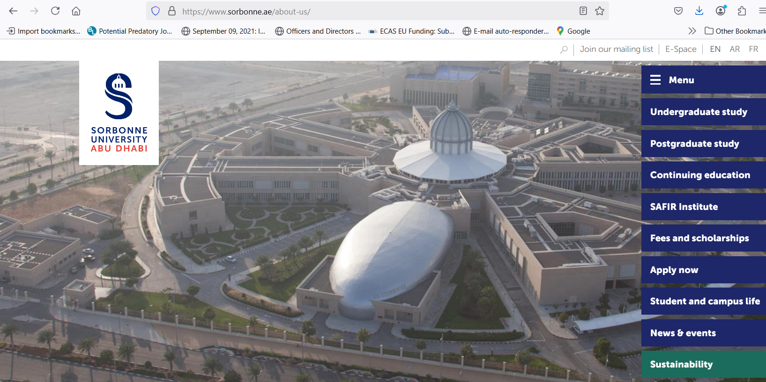




Abu Dhabi Education

Slide 16
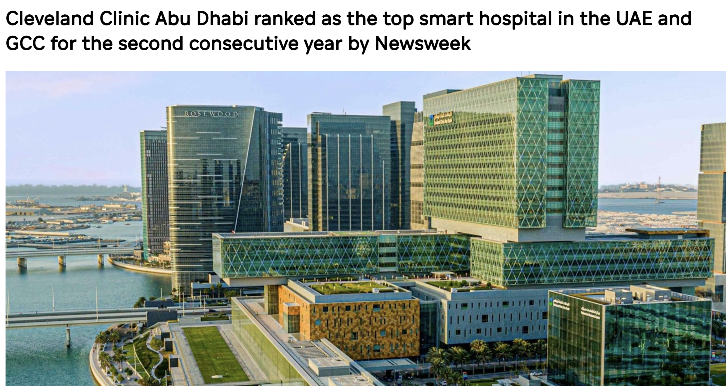

Abu Dhabi Healthcare

Slide 17
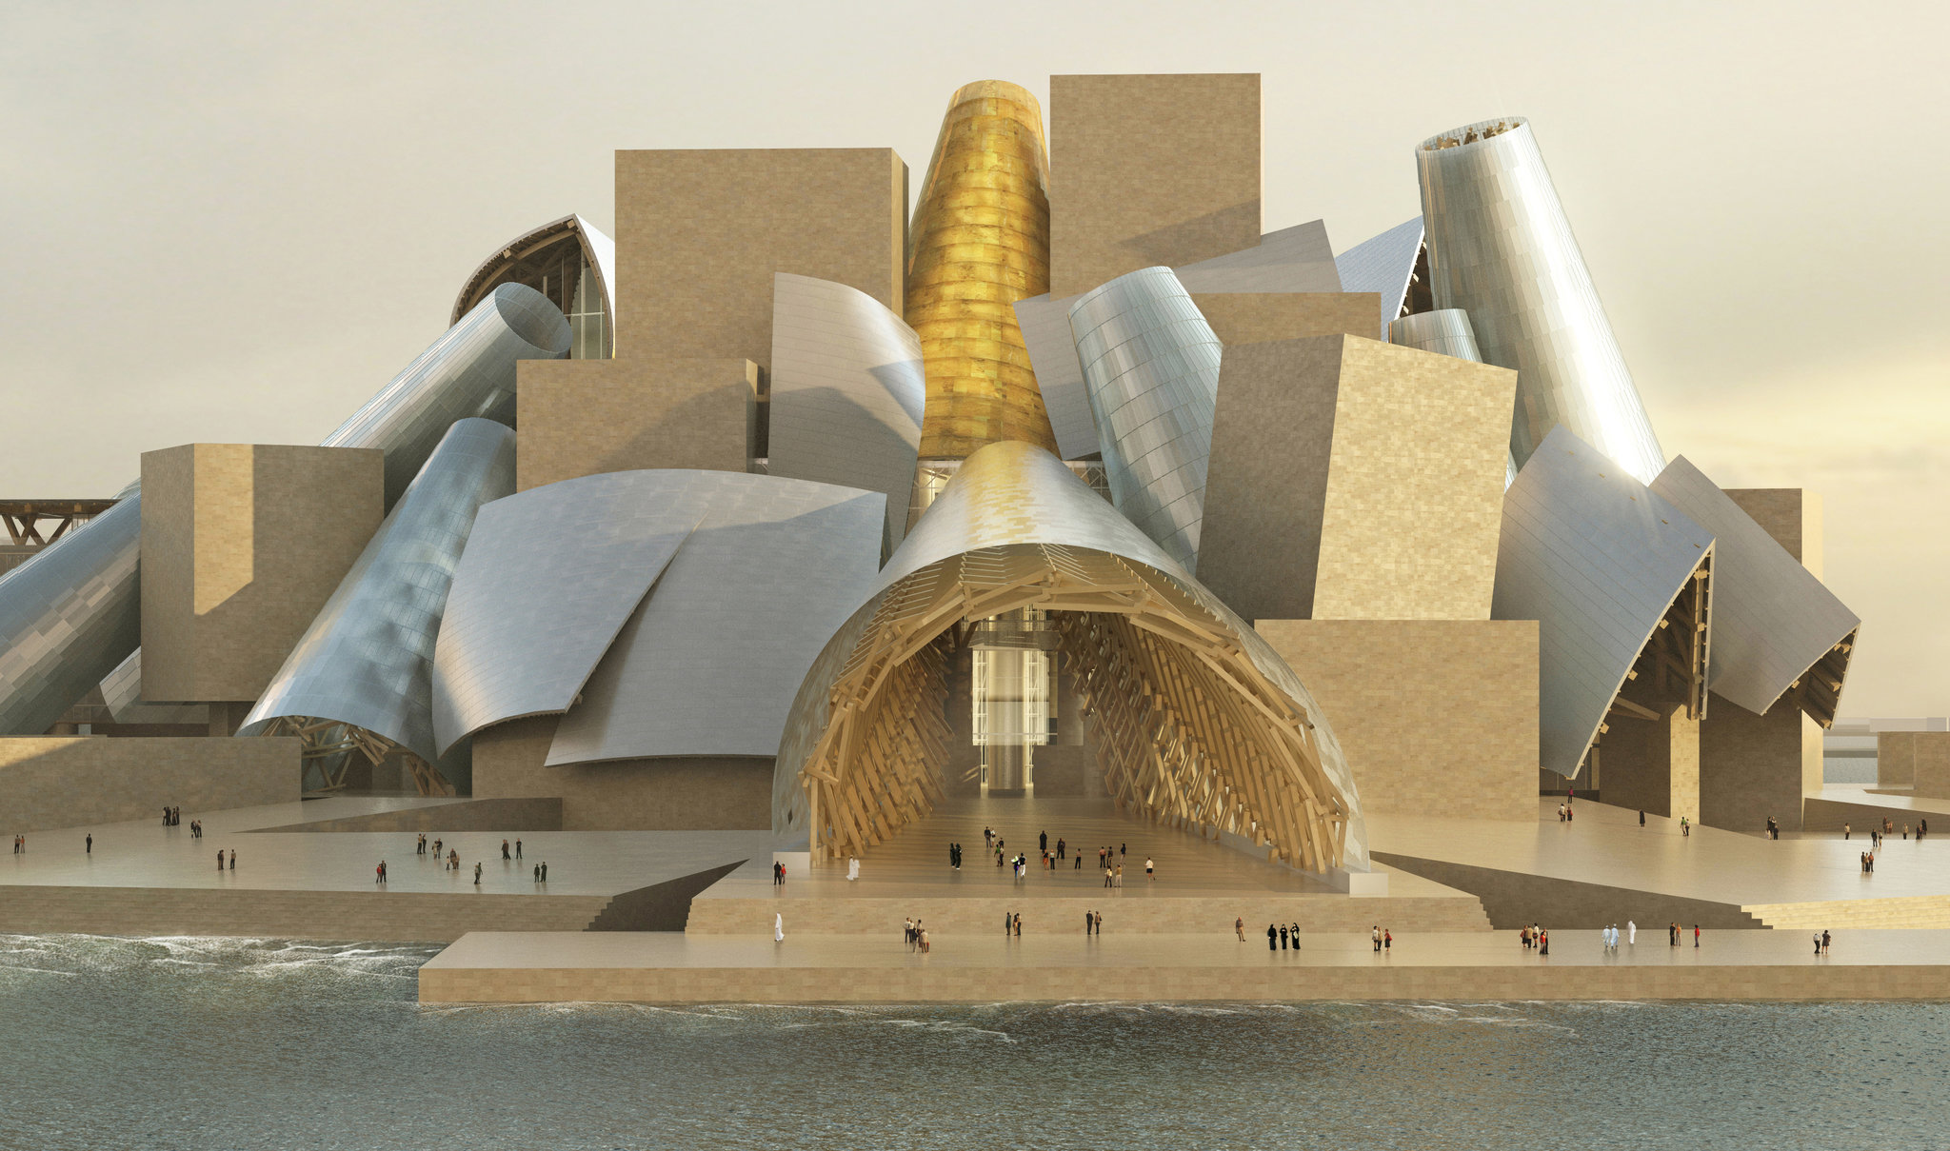
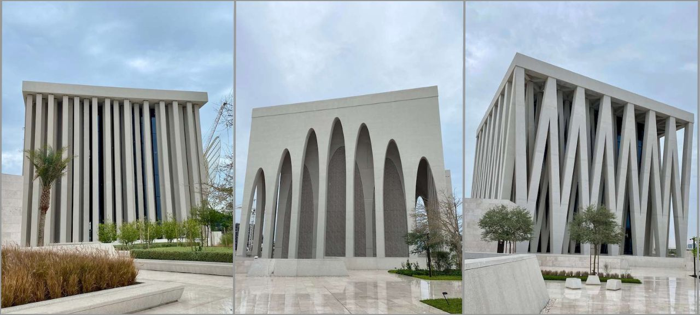




Abu Dhabi Culture

Slide 18
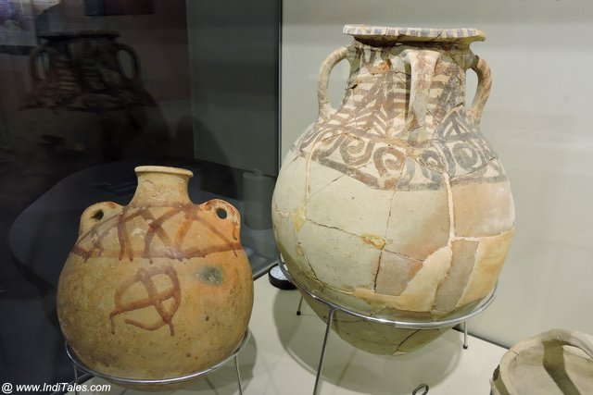

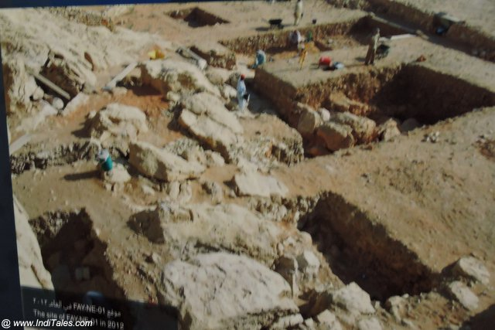
Abu Dhabi Origins
8,000 years ago

Slide 19


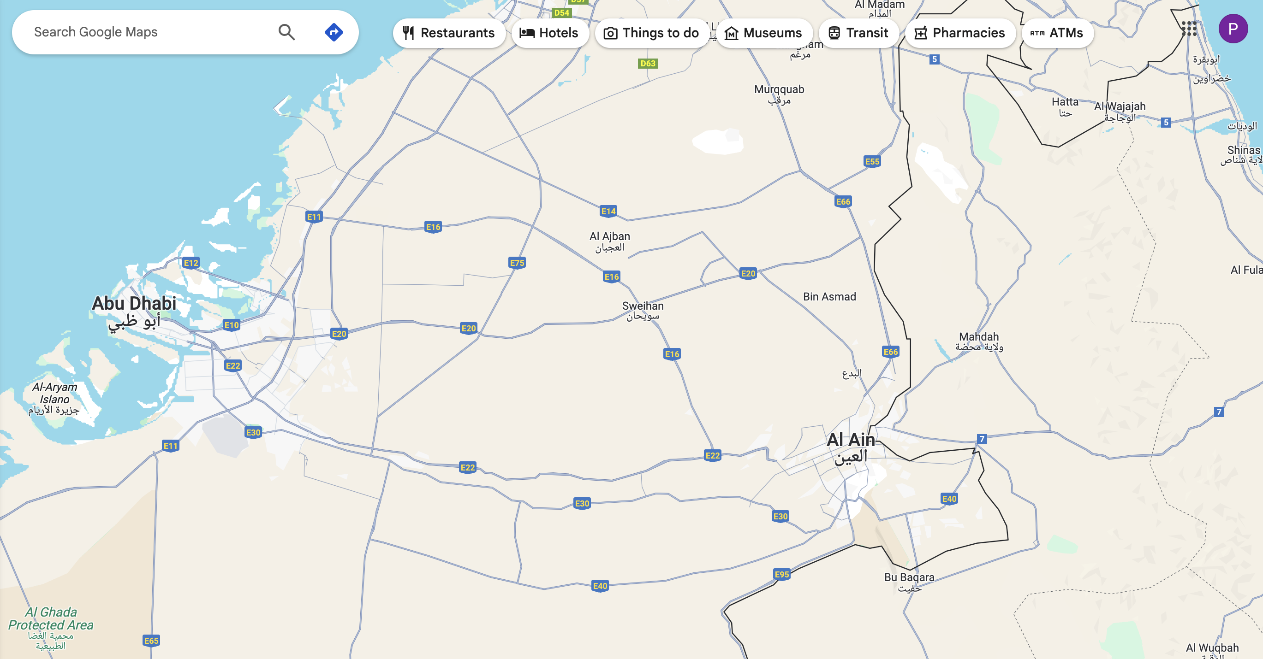

Abu Dhabi Origins

Slide 20

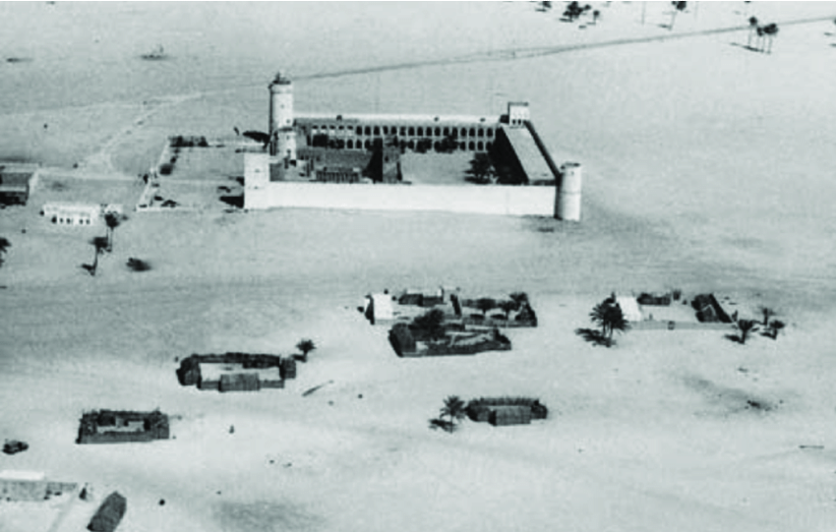
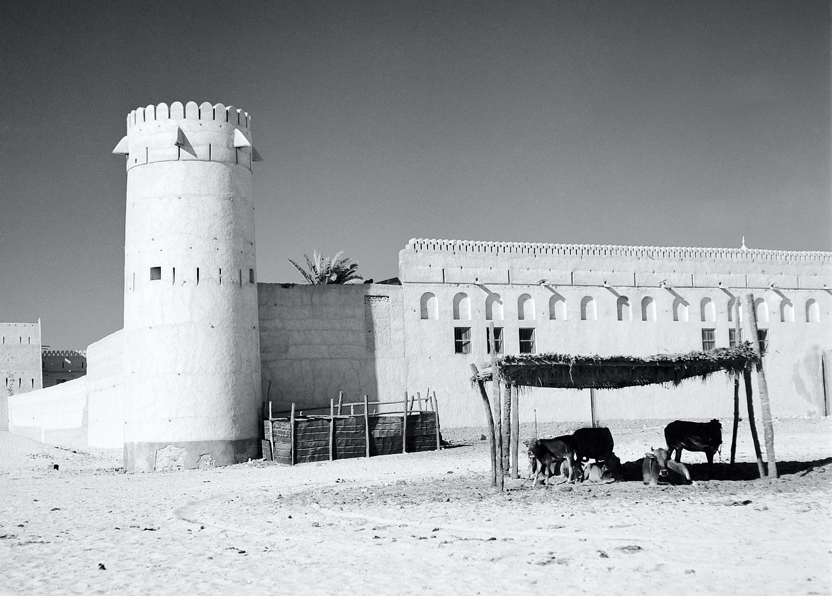
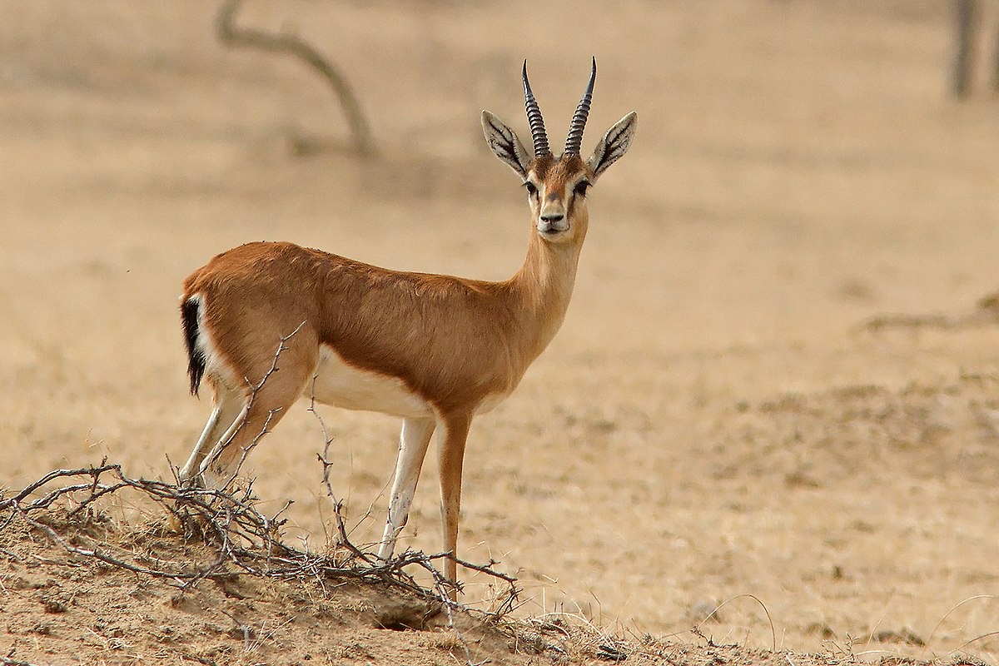
Abu Dhabi Origins

Slide 21


Current position: leader in AI…

Slide 22

Open positions:

Slide 23

Open positions:

Slide 24

Open positions:

Slide 25

Open positions:
STUDENTS: Free to study & live + generous stipends (€3K / month, no tax)
STUDENTS: apply by the end of May 2025)

Slide 26
€1.6M ERC StG, 2012-2017; €2M ERC CoG, 2018-2025;
ERC Proof of Concpet Grant, 2020-2023.
New AI Methods for Simplifying Multi-Omics Data Analyses in Precision Medicine
Nataša Pržulj
Professor
Computational Biology
MBZUAI
Professor of Computer Science ICREA
University College London Spain
E-mail: Natasa.Przulj@mbzuai.ac.ae

Slide 27

Overview
Medicine: complex world of inter-connected entities (networks)
Motivation and Background
New Methods to Jointly Embed Multi-Omics Data
Precision Medicine Applications
New Network Embedding Paradigms:
Linearizing the embedding space
Meaning of axes of joint embedding
biological function, disease, evolution
Conclusions and Future Directions

Slide 28
Overview
Medicine: complex world of inter-connected entities (networks)
Motivation and Background
New Methods to Jointly Embed Multi-Omics Data
Precision Medicine Applications
New Network Embedding Paradigms:
Linearizing the embedding space
Meaning of axes of joint embedding
biological function, disease, evolution
Conclusions and Future Directions

Slide 29
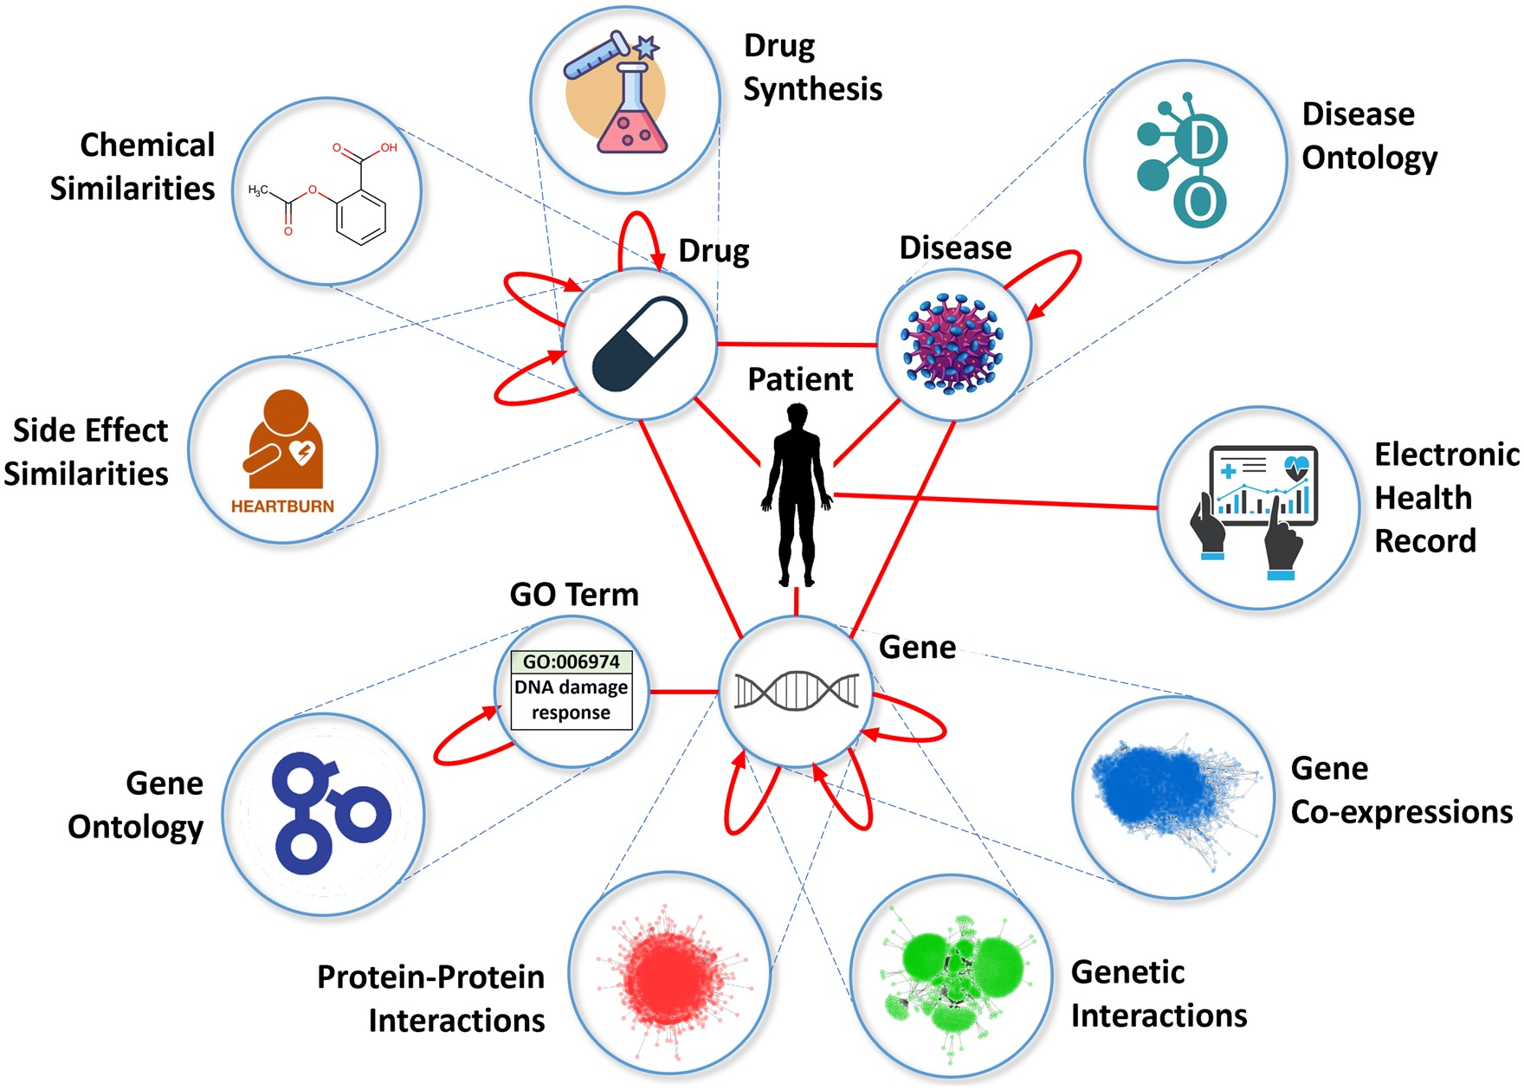

1. Motivation and Background
Medicine: complex world of inter-connected entities
Technological advances →
astounding harvest of various molecular and clinical data
Connectedness of biomedical network data
N. Pržulj and N. Malod-Dognin, “Simplicity within biological complexity,” Bioinformatics Advances, 5(1), Feb. 6, 2025
M. Zitnik et al., “Current and future directions in network biology,” Bioinformatics Advances, 4(1), 2024

Slide 30
1. Motivation and Background
Medicine: complex world of inter-connected entities
Elucidate fundamental principles of the multi-omic organization of life
Facilitate understanding and controlled exploitation
Connectedness of biomedical network data
N. Pržulj and N. Malod-Dognin, “Simplicity within biological complexity,” Bioinformatics Advances, 5(1), Feb. 6, 2025
M. Zitnik et al., “Current and future directions in network biology,” Bioinformatics Advances, 4(1), 2024

Slide 31
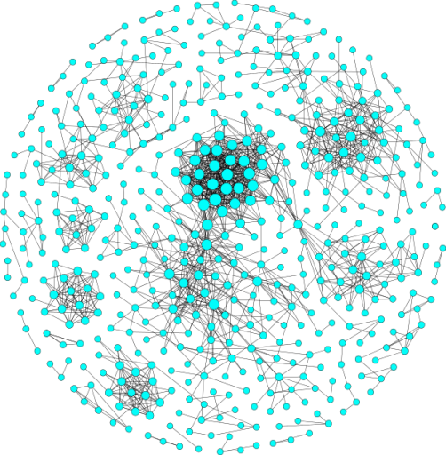
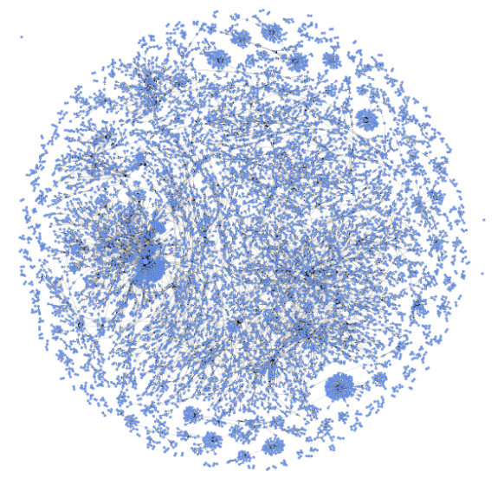
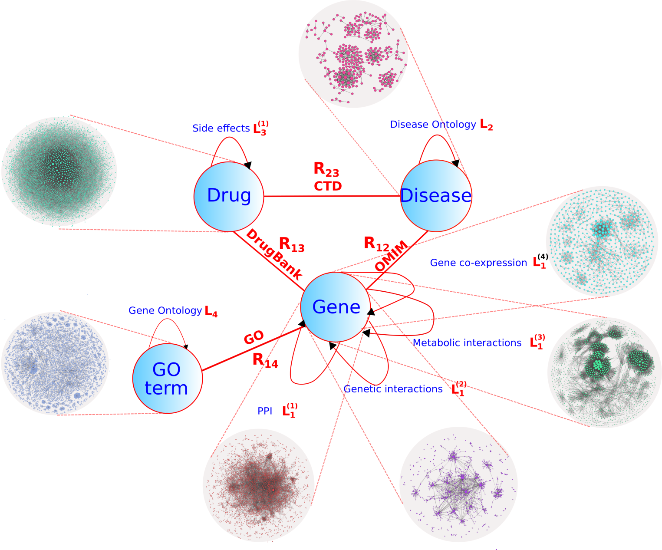
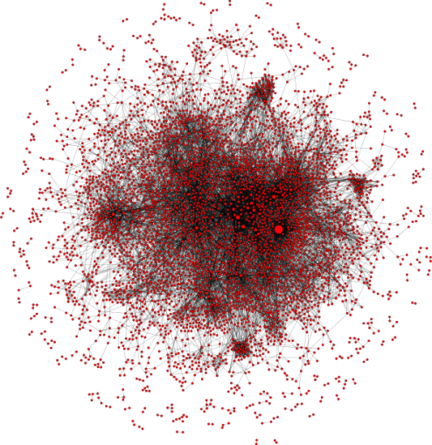
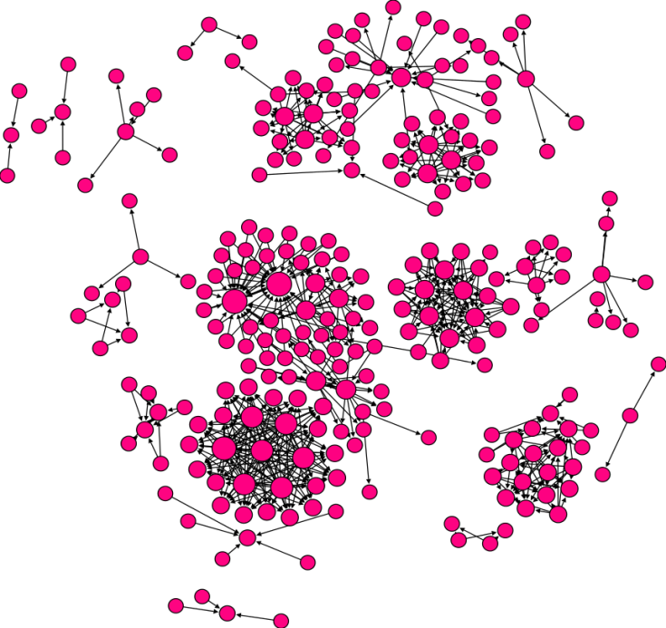
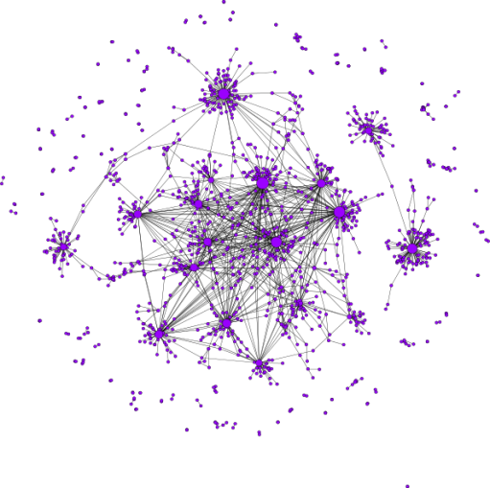
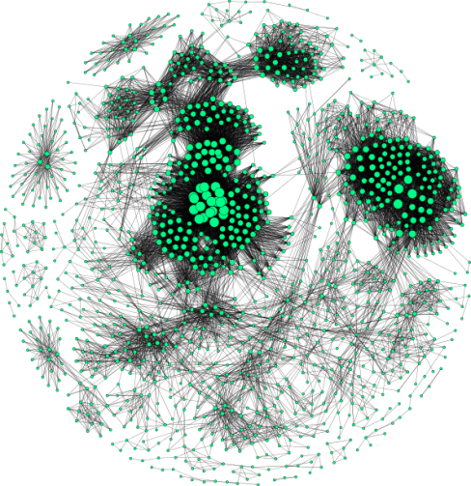
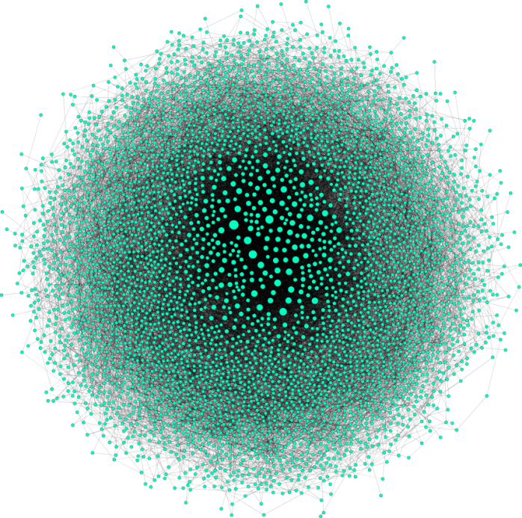
1. Motivation and Background
Medicine: complex world of inter-connected entities
Computational challenges
Computational complexity → heuristics
NON-LINEAR
Gene co-expression
Patient
Drug side-effects
Protein-protein interactions (PPI)
Disease ontology
Genetic interactions
Gene ontology
Metabolic interactions

Slide 32
1. Motivation and Background
Medicine: complex world of inter-connected entities
Currently dominating NN / DL black-box ML methods suffer from:
Uncontrolled & unexpected behavior →
Dangerous
Surprise discoveries, e.g.:
Linear algebraic structure of the word embedding space in NLP (analogies)
Predicting protein 3D structure (trained to predict next a.a. in protein sequence)
Over-parametrization
Lack of robustness to noise
Overfitting
Large carbon footprints …
New paradigms needed:
Explainable
Controllable
New insights:
Emergent nature of biological organization
Non-linear → linear organization?
Sustainable revolution in biomedical applications & exploitation
Reduce carbon footprint
N. Pržulj and N. Malod-Dognin, “Simplicity within biological complexity,” Bioinformatics Advances, 5(1), Feb. 6, 2025
M. Zitnik et al., “Current and future directions in network biology,” Bioinformatics Advances, 4(1), 2024

Slide 33

1. Motivation and Background
Graphlets Mine Inter-Connected Entities – One Network Type
ERC StG: 278212 (2012-2017): "Biological Network Topology Complements Genome as a Source of Biological Information"
Combine Network Topology and ML
Graphlets
“Legos of Networks”
N. Przulj, D. G. Corneil, and I. Jurisica, “Modeling Interactome: Scale Free or Geometric?,” Bioinformatics, vol. 20, num. 18, pg. 3508-3515, 2004.

Slide 34
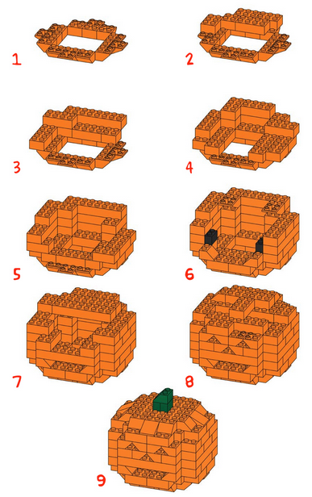
1. Motivation and Background
Graphlets Mine Inter-Connected Entities – One Network Type
ERC StG: 278212 (2012-2017): "Biological Network Topology Complements Genome as a Source of Biological Information"
Combine Network Topology and ML
Graphlets
“Legos of Networks”
N. Przulj, “Biological Network Comparison Using Graphlet Degree Distribution,” Proceedings of the 2006 European Conference on Computational Biology, ECCB '06, Eilat, Israel, January 21-24, 2007, acceptance rate 18%. Bioinformatics, volume 23, pages e177-e183, 2007

Slide 35
1. Motivation and Background
Graphlets Mine Inter-Connected Entities – One Network Type
Combine Network Topology and ML
Graphlets
“Legos of Networks”
B
D
E
A
C
G
F
Combine Network Topology and ML: node feature vector / node embedding
Orbit | 0 | 1 | 2 | 3 | 4 | 5 | 6 | 7 | 8 | 9 | 10 | 11 | 12 | 13 | 14
A | 4 | 3 | 5 | 1 | 0 | 6 | 0 | 2 | 1 | 0 | 1 | 2 | 0 | 0 | 0
B | 2 | 3 | 0 | 1 | 2 | 0 | 1 | 0 | 0 | 0 | 3 | 0 | 0 | 0 | 0
C | 3 | 2 | 2 | 1 | 2 | 2 | 1 | 0 | 0 | 0 | 2 | 1 | 0 | 0 | 0
D | 1 | 2 | 0 | 0 | 2 | 0 | 0 | 0 | 0 | 1 | 0 | 0 | 0 | 0 | 0
E | 2 | 4 | 1 | 0 | 1 | 2 | 2 | 0 | 1 | 1 | 0 | 0 | 0 | 0 | 0
F | 2 | 4 | 1 | 0 | 1 | 2 | 2 | 0 | 1 | 1 | 0 | 0 | 0 | 0 | 0
G | 2 | 2 | 1 | 0 | 4 | 0 | 0 | 0 | 1 | 0 | 0 | 0 | 0 | 0 | 0
Orbit | 0 | 1 | 2 | 3 | 4 | 5 | 6 | 7 | 8 | 9 | 10 | 11 | 12 | 13 | 14
A | 4 | 3 | 5 | 1 | 0 | 6 | 0 | 2 | 1 | 0 | 1 | 2 | 0 | 0 | 0

Slide 36

1. Motivation and Background
Graphlets Mine Inter-Connected Entities – One Network Type
The best performing
Robust
PPI networks are geometric
€1.6M ERC StG for 2012-2017
N. Pržulj, D. G. Corneil, and I. Jurisica, “Modeling Interactome: Scale Free or Geometric?,” Bioinformatics, vol. 20, num. 18, pg. 3508-3515, 2004; Cited 931 times.
N. Pržulj, “Biological Network Comparison Using Graphlet Degree Distribution,” Proceedings of ECCB '06, Eilat, Israel, acceptance rate 18%. Bioinformatics, 23, e177-e183, 2007; Cited 1,158 times.
Used in ML algorithms ...
Directed
Probabilistic
Hyper-graphlets, Hyper-graphlet kernels, Simplets
Graphlet Laplacians
Generalized spectral embedding and clustering
Different and complementary annotations
Graphlet eigencentralities: central roles of genes in pathways
SFL Windels, D Tello Velasco, M Rotkevich, N Malod-Dognin, N Pržulj, “Graphlet-based hyperbolic embeddings capture evolutionary dynamics in genetic networks,” Bioinformatics 40 (11), btae650, 2024
SFL Windels, N Malod-Dognin, N Pržulj, “Graphlets correct for the topological information missed by random walks,” arXiv:2405.14194, 2024

Slide 37
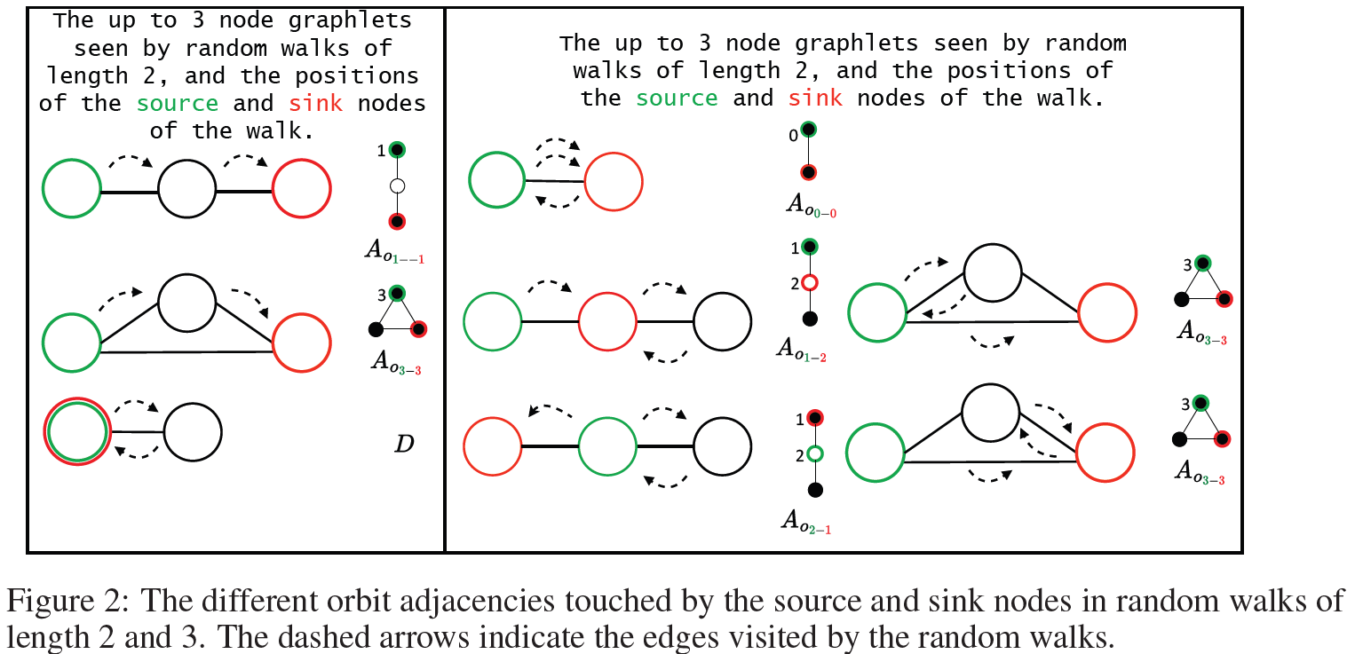
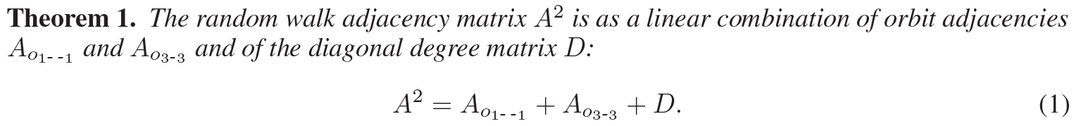
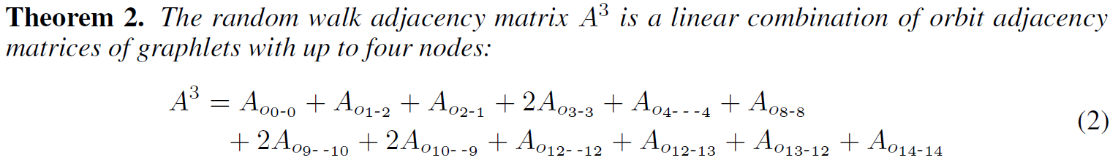
1. Motivation and Background – New
Graphlets Mine Inter-Connected Entities – One Network Type
SFL Windels, D Tello Velasco, M Rotkevich, N Malod-Dognin, N Pržulj, “Graphlet-based hyperbolic embeddings capture evolutionary dynamics in genetic networks,” Bioinformatics 40 (11), btae650, 2024
SFL Windels, N Malod-Dognin, N Pržulj, “Graphlets correct for the topological information missed by random walks,” arXiv:2405.14194, 2024

Slide 38

1. Motivation and Background
Graphlets Mine Inter-Connected Entities – One Network Type
→ embeddings

Slide 39

1. Motivation and Background
Graphlets Mine Inter-Connected Entities – One Network Type
2024
✔
✔
✔
✔

Slide 40

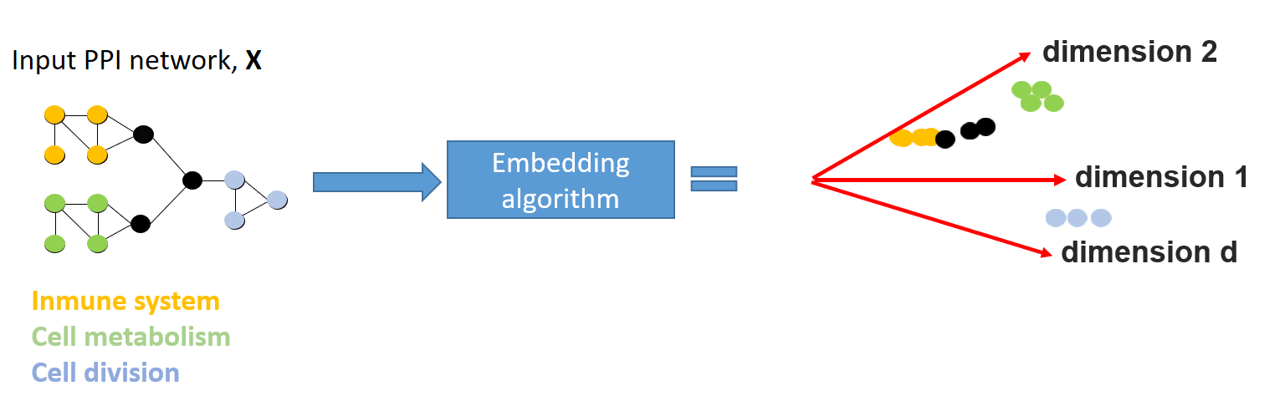
1. Motivation and Background
Node embedding – One network type
To ease the computational burden of mining large, complex datasets, current approaches rely on network / node embeddings
Principle:
Map nodes to lower dimensional space, where
The geometry of the space reflects the similarities between the nodes
Low-dimensional embedding vectors of the nodes are used as input for downstream analysis (e.g., clustering, link predictions, etc…)
A Xenos, N Malod-Dognin, S Milinković, N Pržulj, "Linear functional organization of the omic embedding space," Bioinformatics 37 (21), 3839-47, 2021
Sergio Doria-Belenguer, Alexandros Xenos, Gaia Ceddia, Noël Malod-Dognin, Nataša Pržulj, “A functional analysis of omic network embedding spaces reveals key altered functions in cancer,” Bioinformatics 39 (5), btad281, 2023

Slide 41
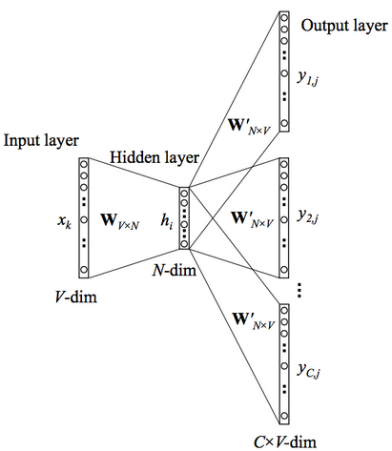
1. Motivation and Background
Node embedding – One network type
Inspired by Natural Language Processing (NLP)
Word embeddings: e.g. Word2Vec, with the Skip-Gram NN architecture
1-layer with non-linear softmax activation function
Maximizes the dot-product of vectors of words that co-occur in the lexical corpus
Given an unlabelled training corpus, produce vectors for words encoding their semantic info.
Word semantic similarity (synonyms) by cosine similarity of their vector representations
Use word vectors as features in various supervised NLP tasks, e.g.:
Document classification
Named entity recognition / information retrieval
A Xenos, N Malod-Dognin, S Milinković, N Pržulj, "Linear functional organization of the omic embedding space," Bioinformatics 37 (21), 3839-47, 2021
Sergio Doria-Belenguer, Alexandros Xenos, Gaia Ceddia, Noël Malod-Dognin, Nataša Pržulj, “A functional analysis of omic network embedding spaces reveals key altered functions in cancer,” Bioinformatics 39 (5), btad281, 2023

Slide 42
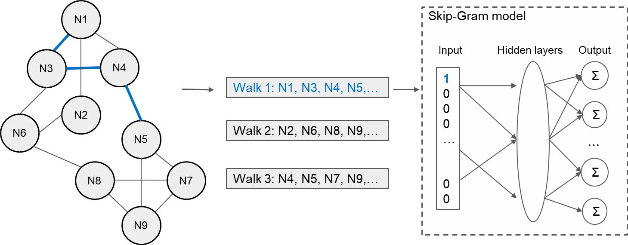
1. Motivation and Background
Node embedding – One network type
Network data mining
Network embeddings:
Random-walk based NNs that employ the Skip-Gram architecture (e.g., DeepWalk, LINE and Node2Vec)
Graph Neural Networks (GNNs)
Fig. Illustration of Skip-Gram NN based network embedding.
A Xenos, N Malod-Dognin, S Milinković, N Pržulj, "Linear functional organization of the omic embedding space," Bioinformatics 37 (21), 3839-47, 2021
Sergio Doria-Belenguer, Alexandros Xenos, Gaia Ceddia, Noël Malod-Dognin, Nataša Pržulj, “A functional analysis of omic network embedding spaces reveals key altered functions in cancer,” Bioinformatics 39 (5), btad281, 2023

Slide 43
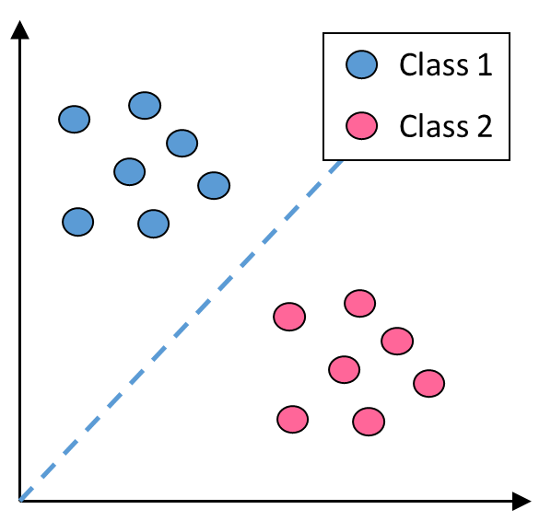
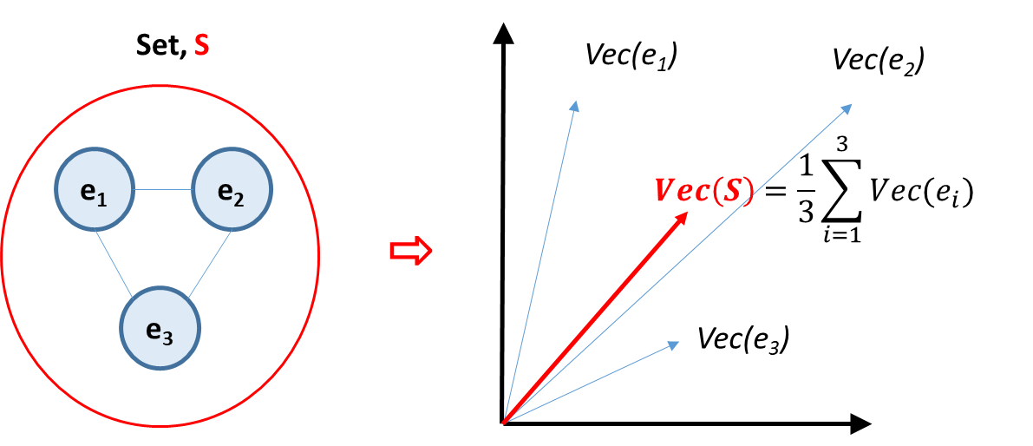
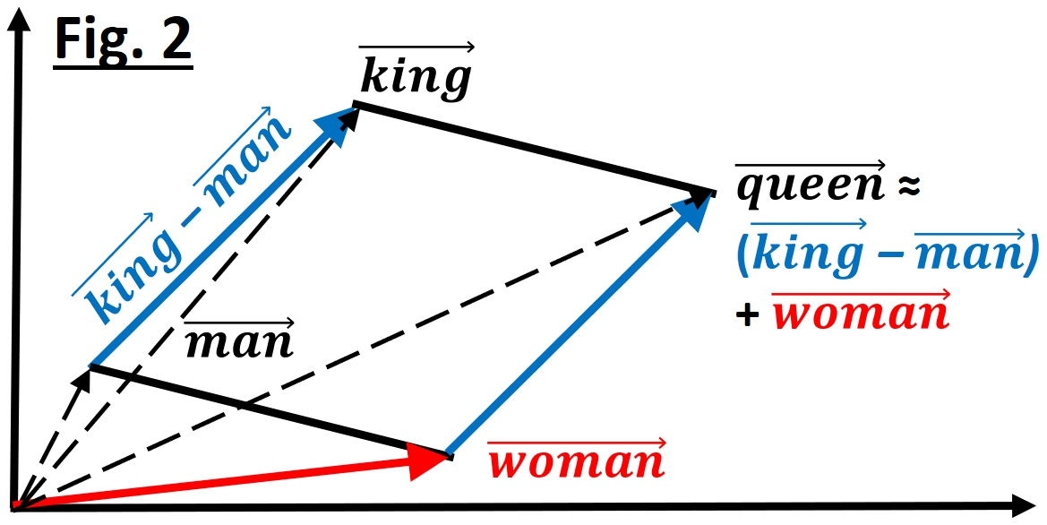
1. Motivation and Background
Node embedding – One network type
Interestingly, from NLP, for word embeddings
(Mikolov, Sutskever et al., NIPS, 2013)
LINEARITY OF THE EMBEDDING SPACES:
Class separability: The vector representations of elements belonging to different classes are linearly separated in the embedding space
Vector summation: relevant embedding vector for a set (sentence, paragraph) can be obtained as the sum / average of the embedding vectors of its constituent elements
Surprise – Analogy (with limitations):
“queen:woman :: king:man”
→ linear operation on the words’ embedding vectors:
vec(queen) ≈ vec(king) – vec(man) + vec(women)
Motivation:
Do equivalent hold for biological network embeddings?
Can we answer biological questions using simple vector operations?
1
2
3
A Xenos, N Malod-Dognin, S Milinković, N Pržulj, "Linear functional organization of the omic embedding space," Bioinformatics 37 (21), 3839-47, 2021
Sergio Doria-Belenguer, Alexandros Xenos, Gaia Ceddia, Noël Malod-Dognin, Nataša Pržulj, “A functional analysis of omic network embedding spaces reveals key altered functions in cancer,” Bioinformatics 39 (5), btad281, 2023

Slide 44
1. Motivation and Background
Node embedding – One network type
PROBLEM OF HETEROPHYLIC DATA SETS:
Definition:
For a given set of annotations, a network is:
Homophilic, if elements (nodes) with the same annotations / class are connected;
Otherwise, it is heterophilic
Network embedding methods perform poorly on heterophilic datasets (Alon & Yahav, 2020; Zhu et al., 2020)
Importantly, network embedding methods are mostly tested on toy examples, while:
Biological networks are large, noisy & incomplete
Annotations are also noisy, incomplete, overlapping…
Likely to be heterophilic
This questions the applicability of network embeddings for biological datasets
Class A
Class B
Class C
Fig. Illustration of a homophilic network
A Xenos, N Malod-Dognin, S Milinković, N Pržulj, "Linear functional organization of the omic embedding space," Bioinformatics 37 (21), 3839-47, 2021
Sergio Doria-Belenguer, Alexandros Xenos, Gaia Ceddia, Noël Malod-Dognin, Nataša Pržulj, “A functional analysis of omic network embedding spaces reveals key altered functions in cancer,” Bioinformatics 39 (5), btad281, 2023

Slide 45
1. Motivation and Background
Joint embedding – different node types into the same space
Connectedness of biomedical network data
N. Pržulj and N. Malod-Dognin, “Simplicity within biological complexity,” Bioinformatics Advances, 5(1), Feb. 6, 2025
Sergio Doria-Belenguer, Alexandros Xenos, Gaia Ceddia, Noël Malod-Dognin, Nataša Pržulj, “A functional analysis of omic network embedding spaces reveals key altered functions in cancer,” Bioinformatics 39 (5), btad281, 2023

Slide 46
Overview
Medicine: complex world of inter-connected entities (networks)
Motivation and Background
New Methods to Jointly Embed Multi-Omics Data
Precision Medicine Applications
New Network Embedding Paradigms:
Linearizing the embedding space
Meaning of axes of joint embedding
biological function, disease, evolution
Conclusions and Future Directions

Slide 47
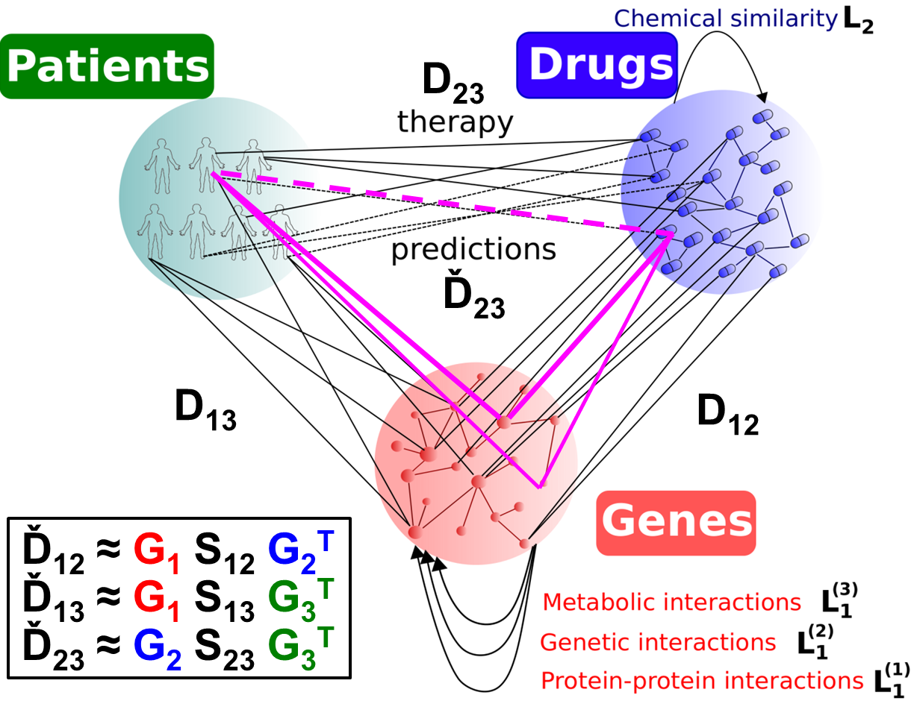
2. Novel Methods
Joint embedding – precision medicine applications
Multi-disciplinary, data-fusion methodology: NMTF
Explainable AI (xAI):
Captures all systems-level
Captures how data relate
Mechanistic explanations
NOT data / energy hungry
PNMTF → Personalize Treatment
NMTF Enables:
Dimensionality reduction
Co-clustering
Data Fusion
Orthogonality
Inference (in Ď_{ij})
min{∑_{1≤i≤j≤p} [ ||W_{ij} ○(D_{ij} – G_{i}S_{ij}G_{j}^{T})||² + α ||S_{ij}||²+ α_{i} tr(G_{i}^{T}L_{i}G_{i}) + α_{j} tr(G_{j}^{T}L_{j}G_{j})] : G_{i},S_{ij} ≥ 0}
α ||S_{ij}||² maintain sparsity of S_{ij} , α_{i} tr(G_{i}^{T}L_{i}G_{i}) and α_{j} tr(G_{j}^{T}L_{j}G_{j}) adding prior knowledge (penalties),
G_{i}, S_{ij} ≥ 0 is needed for cluster interpretation

Slide 48
2. Novel Methods
Joint embedding – precision medicine applications
Multi-disciplinary, data-fusion methodology: NMTF
Explainable AI (xAI):
Captures all systems-level
Captures how data relate
Mechanistic explanations
NOT data / energy hungry
PNMTF → Personalize Treatment
NMTF Enables:
Dimensionality reduction
Co-clustering
Data Fusion
Orthogonality
Inference (in Ď_{ij})
min{∑_{1≤i≤j≤p} [ ||W_{ij} ○(D_{ij} – G_{i}S_{ij}G_{j}^{T})||² + α ||S_{ij}||²+ α_{i} tr(G_{i}^{T}L_{i}G_{i}) + α_{j} tr(G_{j}^{T}L_{j}G_{j})] : G_{i},S_{ij} ≥ 0}
α ||S_{ij}||² maintain sparsity of S_{ij} , α_{i} tr(G_{i}^{T}L_{i}G_{i}) and α_{j} tr(G_{j}^{T}L_{j}G_{j}) adding prior knowledge (penalties),
G_{i}, S_{ij} ≥ 0 is needed for cluster interpretation

Slide 49

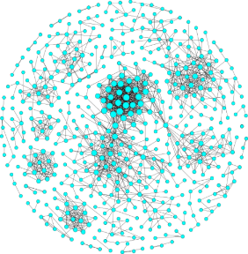
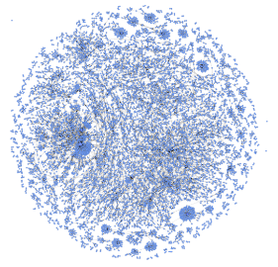




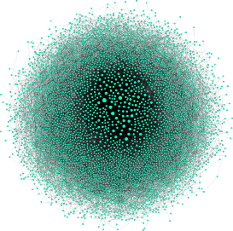


2. Novel Methods
Joint embedding – precision medicine applications: cancer
€2M European Research Council (ERC) Consolidator Grant, 2018-2025;
ERC Proof of Concpet Grant, 2020-2023.
Different data types complement each other
Cancer
Healthy
Gene
co-expressions
(COEXPRESdb)
iCell
Comparison
iCell
Protein-protein interactions
(IID)
Genetic Interactions
New cancer genes
(BioGRID and SynLethDB)
Tissue-specific gene expression: Human Protein Atlas (HPA)
Noël Malod-Dognin, Julia Petschnigg, Sam F. L. Windels, Janez Povh, Harry Hemmingway, Robin Ketteler and Nataša Pržulj,
“iCell: integrated cells uncover new cancer genes,” Nature Communications 10:805, 2019

Slide 50
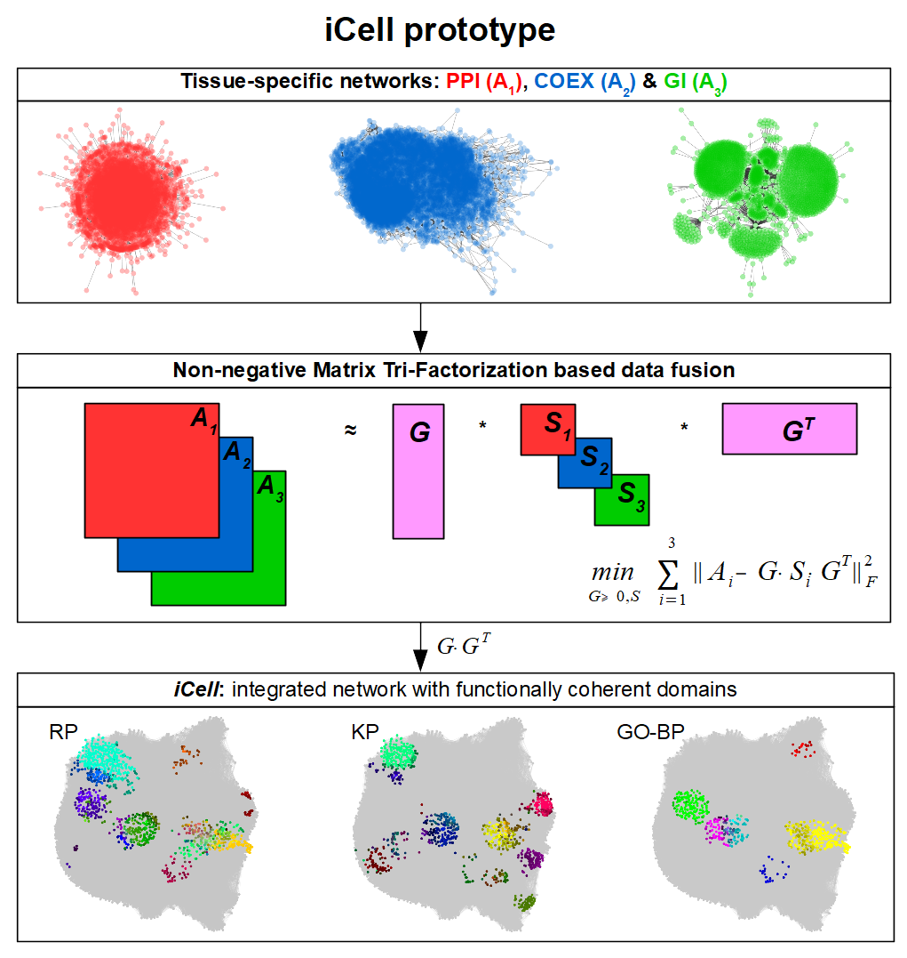
2. Novel Methods
Joint embedding – precision medicine applications: cancer
Noël Malod-Dognin, Julia Petschnigg, Sam F. L. Windels, Janez Povh, Harry Hemmingway, Robin Ketteler and Nataša Pržulj,
“iCell: integrated cells uncover new cancer genes,” Nature Communications 10:805, 2019

Slide 51
2. Novel Methods
Joint embedding – precision medicine applications: cancer
iCells capture:
additional functional info
emerging from the fusion
despite ≈ no network overlap
Clusters: k-means equivalent
Noël Malod-Dognin, Julia Petschnigg, Sam F. L. Windels, Janez Povh, Harry Hemmingway, Robin Ketteler and Nataša Pržulj,
“iCell: integrated cells uncover new cancer genes,” Nature Communications 10:805, 2019

Slide 52
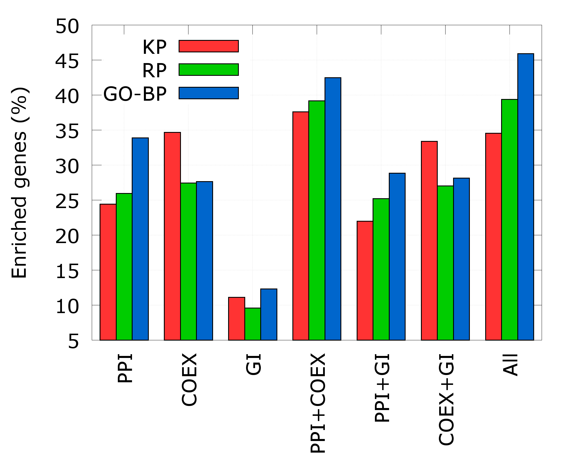
2. Novel Methods
Joint embedding – precision medicine applications: cancer
Contributions of data sets
Noël Malod-Dognin, Julia Petschnigg, Sam F. L. Windels, Janez Povh, Harry Hemmingway, Robin Ketteler and Nataša Pržulj,
“iCell: integrated cells uncover new cancer genes,” Nature Communications 10:805, 2019

Slide 53
2. Novel Methods
Joint embedding – precision medicine applications: Covid-19
Step 1:
Covid-19
Control
Gene
co-expressions
(COEXPRESdb)
iCell
Comparison
iCell
Protein-protein interactions
(IID)
Genetic Interactions
New Covid genes
(BioGRID and SynLethDB)
Tissue-specific gene expression data:
for A549, NHBE, and CALU cell lines – control and infected
lung samples from COVID-19 positive patients and healthy individuals (Blanco Melo et al., Cell,181, 2020)
Alexandros Xenos, Noël Malod-Dognin, Carme Zambrana and Nataša Pržulj,
“Integrated Data Analysis Uncovers New COVID-19 Related Genes and
Potential Drug Re-Purposing Candidates,” Int. J. Mol. Sci., 24(2), 1431, 2023

Slide 54
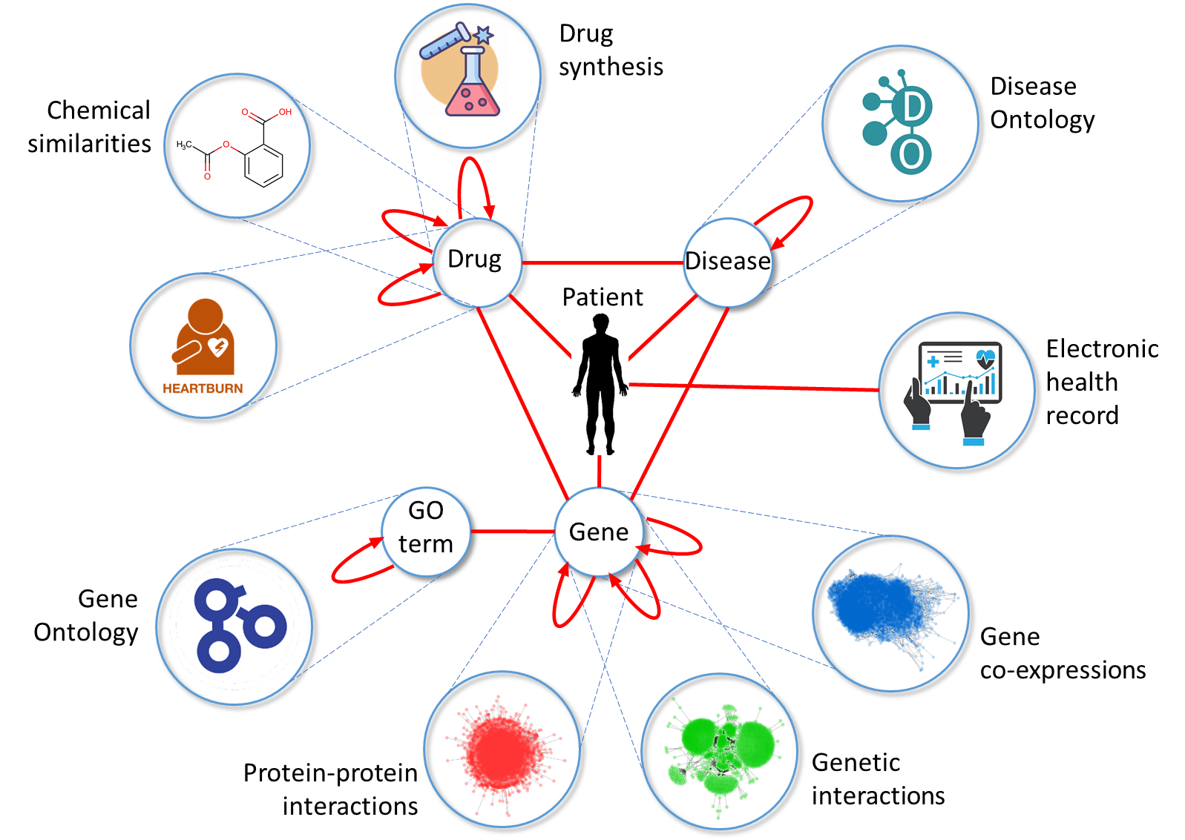
2. Novel Methods
Joint embedding – precision medicine applications: Covid-19
Step 1 and 2:
k₁
A₃
S₁
PPI
G_{infected}
G_{infected}^{T}
k₁
1.
k₁
genes
genes
S₂
CoEx
≈
A₁
GI
S₃
Patient iCell
drugs
k₁
k₂
drugs
R₁₂: Drug-Target Interactions (DTI)*
≈
G_{infected}
k₂
G₂ ^{T}
2.
k₁
H₁₂
genes
DCS
* DrugBank v 5.1.3
genes
1.
Alexandros Xenos, Noël Malod-Dognin, Carme Zambrana and Nataša Pržulj,
“Integrated Data Analysis Uncovers New COVID-19 Related Genes and
Potential Drug Re-Purposing Candidates,” Int. J. Mol. Sci., 24(2), 1431, 2023

Slide 55
2. Novel Methods
Joint embedding – precision medicine applications: Covid-19
Step 1 and 2:
k₁
A₃
S₁
PPI
G_{infected}
G_{infected}^{T}
k₁
1.
k₁
genes
genes
S₂
CoEx
≈
A₁
GI
S₃
Patient iCell
drugs
k₁
k₂
drugs
R₁₂: Drug-Target Interactions (DTI)*
≈
G_{infected}
k₂
G₂ ^{T}
2.
k₁
H₁₂
genes
DCS
* DrugBank v 5.1.3
genes
2.
1.
Alexandros Xenos, Noël Malod-Dognin, Carme Zambrana and Nataša Pržulj,
“Integrated Data Analysis Uncovers New COVID-19 Related Genes and
Potential Drug Re-Purposing Candidates,” Int. J. Mol. Sci., 24(2), 1431, 2023

Slide 56
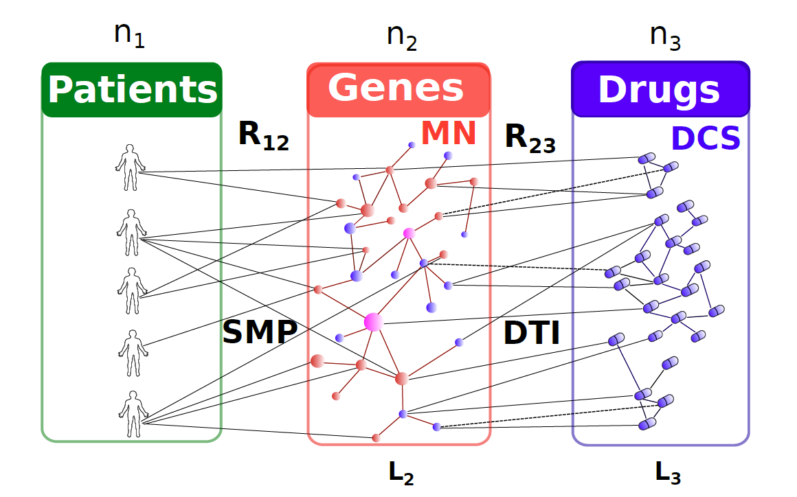



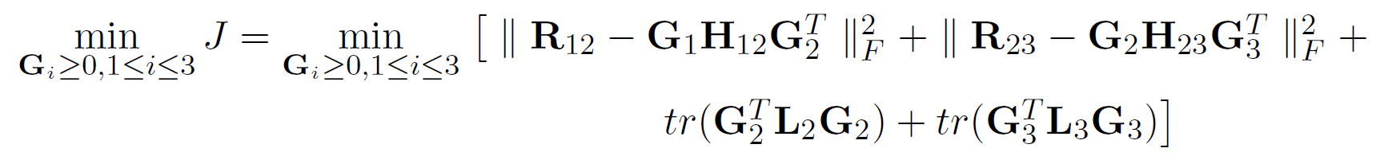
2. Novel Methods
Joint embedding: NOT data / energy hungry: Cancer
Patient-Specific Data Fusion → Personalized Treatment
Co-clustering: patients, genes and drugs
Data:
BioGRID, KEGG:
PPI, GI, MI
DrugBank:
DTI
DrugBank:
SMILES
R₁₂ ≈ G₁ H₁₂ G₂^{T}
R₂₃ ≈ G₂ H₂₃ G₃^{T}
TCGA
k₁« n₁ – patient clusters
k₂« n₂ – gene clusters
k₃ « n₃ – drug clusters
G₁, G₂ and G₃ are cluster
indicator matrices
Ovarian cancer patients:
Patient stratification →
Cancer gene prediction →
Drug repurposing →
Targets /
biomarkers
V. Gligorijevic, N. Malod-Dognin and N. Pržulj, Patient-specific data fusion for cancer stratification and personalized treatment, PSB, 2016

Slide 57
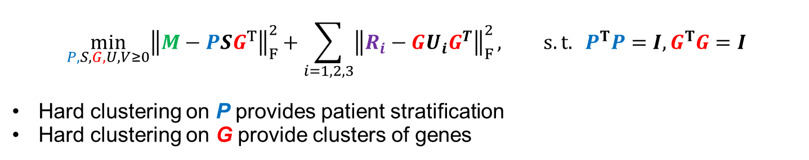
2. Novel Methods
Joint embedding: NOT data / energy hungry: Rare thromboph.
Brother 1 (B₁)
Brother 2 (B₂)
Sister 1 (S₁)
Sister 2 (S₂)
Diseased
Healthy
Diseased
Diseased
Diseased
Daughter 1 (D₁)
Patients
Genes
PPIs, R₁
COEXs, R₂
GIs, R₃
Germline
Mutations, M
$$\min_{P,S,G,U,V≥0}{{\left\|M−PSG^{T}\right\|}_{F}^{2}+\sum_{i=1,2,3}{{\left\|R_{i}−GU_{i}G^{T}\right\|}_{F}^{2}}, s.t. P^{T}P=I,G^{T}G=I}$$
Hard clustering on P provides patient stratification
Hard clustering on G provide clusters of genes
Noel Malod-Dognin, Gaia Ceddia, Maja Gvozdenov, Branko Tomic, Sofija Dunjic Manevski, Valentina Djordjevic and Nataša Pržulj, “A phenotype driven integrative framework uncovers molecular mechanisms of a rare hereditary thrombophilia,” PLoS ONE, April 25, 2023

Slide 58
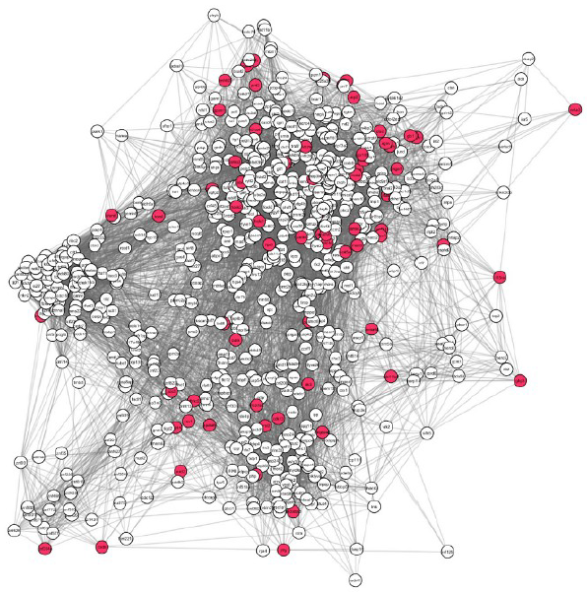
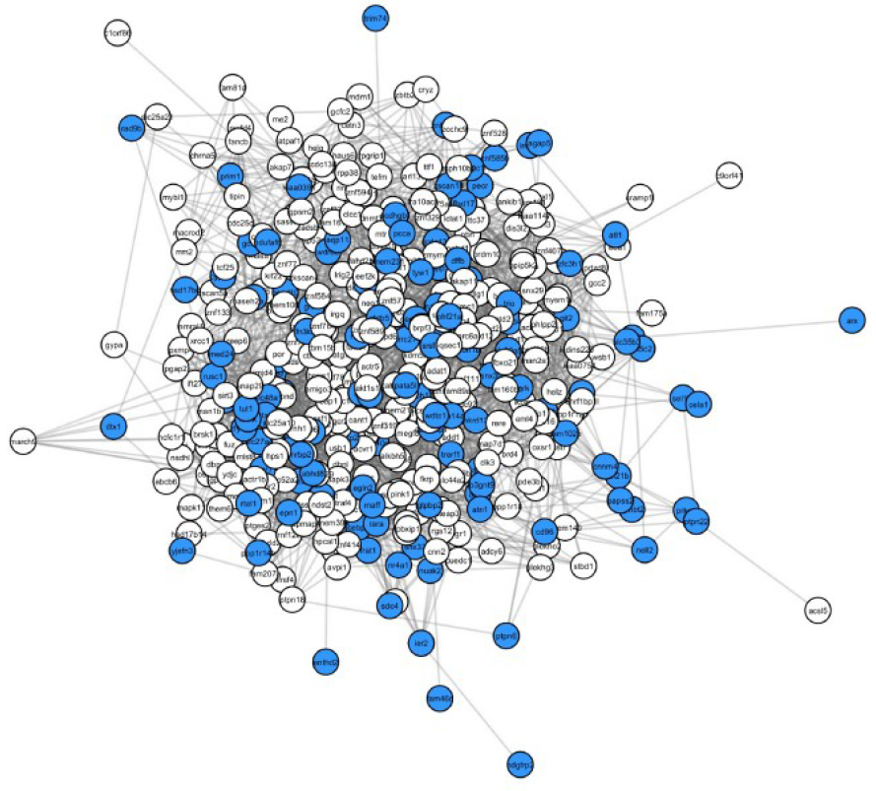
2. Novel Methods
Joint embedding: NOT data / energy hungry: Rare thromboph.
Brother 1 (B₁)
Brother 2 (B₂)
Sister 1 (S₁)
Sister 2 (S₂)
Diseased
Healthy
Diseased
Diseased
Diseased
Daughter 1 (D₁)
Mutated in all diseased: B₁, D₁, S₁, S₂
Mutated in healthy, B2
Noel Malod-Dognin, Gaia Ceddia, Maja Gvozdenov, Branko Tomic, Sofija Dunjic Manevski, Valentina Djordjevic and Nataša Pržulj, “A phenotype driven integrative framework uncovers molecular mechanisms of a rare hereditary thrombophilia,” PLoS ONE, April 25, 2023

Slide 59

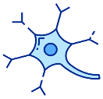
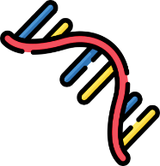











2. Novel Methods
Time-series multi-omics single-cell data – E.g. Parkinson’s
Phenotype Data – Parkinson’s disease
Experimental data
IPSC → mDA
PD: PINK1-mutation
Each cell condition
scRNA-seq
10,5 – 13,7k expressed genes
Cell line
Bernini, M., et al. (2024). In prep
Control
Bulk proteomics
7,380 proteins
IPSC: induced pluripotent stem cell
$$day \left(D\right)8$$
$$D15$$
$$D25$$
$D$32
$D$37
P
Prior Knowledge Data
Bulk metabolomics
96 metabolites
MI
(metabolic interaction)
PPI, GI
(protein-protein interaction,
genetic interaction)
COEX
(co-expression)
Katarina Mihajlović, Noël Malod-Dognin, Corrado Ameli, Alexander Skupin, Nataša Pržulj, “MONFIT: Multi-omics factorization-based integration of time-series data sheds light on Parkinson’s disease,” NAR Molecular Medicine, 1 (4), 2024
59
Notes:
B, basis of the gene embedding space G₁

Slide 60


















Joint embedding of all data
2. Novel Methods
Time-series multi-omics single-cell data – E.g. Parkinson’s
NetSC-NMTF data integration framework
$$n$$
$$k1$$
$$k1$$
$$n$$
Simultaneous decomposition
PPI
≈
*
S₁
*
$$k1$$
G₁^{T}
GI
G₁
S₂
$$n$$
$$n$$
$$k1$$
Prior knowledge:
COEX
S₃
MI
S₄
$$m$$
$$k1$$
$$k2$$
$$m$$
E
≈
S₅
$$k2$$
Phenotype (sc)
Disease / Control:
$$n$$
$$n$$
*
$$k1$$
*
G₂^{T}
G₁
$$U=G_{1}{∗S}_{5}$$
“gene embeddings”
$$\min_{G_{1}G_{2}S_{i}S_{5}}\left[\sum_{i=1}^{4}{{\left\|{w_{i}A}_{i}−G_{1}∙S_{i}∙G_{1}^{T}\right\|}_{F}^{2} + {\left\|w_{E}E−G_{1}∙S_{5}∙G_{2}^{T}\right\|}_{F}^{2}}\right]$$
Katarina Mihajlović, Noël Malod-Dognin, Corrado Ameli, Alexander Skupin, Nataša Pržulj, “MONFIT: Multi-omics factorization-based integration of time-series data sheds light on Parkinson’s disease,” NAR Molecular Medicine, 1 (4), 2024

Slide 61


2. Novel Methods
Time-series multi-omics single-cell data – E.g. Parkinson’s
Control: Gene embeddings in $U_{T_{i}}^{C}$
Disease: Gene embeddings in $U_{T_{i}}^{D}$
dimension k₂
dimension k₂’
gene₂
gene₃
gene₂
gene₃
gene₅
gene₄
Has the gene moved?
gene₅
gene₄
gene₆
gene₁
gene₆
gene₈
gene₁
gene₈
gene₇
gene₇
dimension 2
dimension 1
dimension 1
dimension 2
Predict new disease genes and drug-repurposing candidates
Katarina Mihajlović, Noël Malod-Dognin, Corrado Ameli, Alexander Skupin, Nataša Pržulj, “MONFIT: Multi-omics factorization-based integration of time-series data sheds light on Parkinson’s disease,” NAR Molecular Medicine, 1 (4), 2024

Slide 62
Overview
Medicine: complex world of inter-connected entities (networks)
Motivation and Background
New Methods to Jointly Embed Multi-Omics Data
Precision Medicine Applications
New Network Embedding Paradigms:
Linearizing the embedding space
Meaning of axes of joint embedding
biological function, disease, evolution
Conclusions and Future Directions
A Xenos, N Malod-Dognin, S Milinković, N Pržulj, "Linear functional organization of the omic embedding space," Bioinformatics 37 (21), 3839-47, 2021
Sergio Doria-Belenguer, Alexandros Xenos, Gaia Ceddia, Noël Malod-Dognin, Nataša Pržulj, “A functional analysis of omic network embedding spaces reveals key altered functions in cancer,” Bioinformatics 39 (5), btad281, 2023
Sergio Doria-Belenguer, Alexandros Xenos, Gaia Ceddia, Noël Malod-Dognin, Nataša Pržulj, “The axes of biology: a novel axes-based network embedding paradigm to decipher the functional mechanisms of the cell,” Bioinformatics Advances, vbae075, 2024

Slide 63
2. Novel Methods
Linearizing the embedding space: PPI network of human
Orthogonality constraint on matrix factor B allows for obtaining less correlated basis vectors
Better disentangle the embedding space
dimension 2
dimension 2
Non-Negative Matrix Tri-Factorization (NMTF)
genes
k₁
k₁
genes
gene
≈
gens
d
↔
dimension 1
Network
X
P
S
*
B^{T}
d
*
k₂
k₂
B^{T}B = I
(orthonormality)
dimension d
dimension d
A Xenos, N Malod-Dognin, S Milinković, N Pržulj, "Linear functional organization of the omic embedding space," Bioinformatics 37 (21), 3839-47, 2021
Sergio Doria-Belenguer, Alexandros Xenos, Gaia Ceddia, Noël Malod-Dognin, Nataša Pržulj, “A functional analysis of omic network embedding spaces reveals key altered functions in cancer,” Bioinformatics 39 (5), btad281, 2023

Slide 64

2. Novel Methods
Linearizing the embedding space: PPI network of human
Skip-Gram NN based network embeddings (e.g. DeepWalk, LINE and Node2Vec)
are implicitly factorizing a random-walk-based
Mutual Information matrix, PPMI (Qiu et al., 2018)
where:
vol(G) is the sum of the degrees in the network,
A is the adjacency matrix of the network,
D is the diagonal matrix of degrees of the given network and
T is the length of the random walks.
$$PPMI=max\left(log\left(vol(G)\left(\frac{1}{T}\sum_{r=1}^{T}{{\left(D^{−1}A\right)}^{r}}\right)D^{−1}\right), 0\right)$$
A Xenos, N Malod-Dognin, S Milinković, N Pržulj, "Linear functional organization of the omic embedding space," Bioinformatics 37 (21), 3839-47, 2021
Sergio Doria-Belenguer, Alexandros Xenos, Gaia Ceddia, Noël Malod-Dognin, Nataša Pržulj, “A functional analysis of omic network embedding spaces reveals key altered functions in cancer,” Bioinformatics 39 (5), btad281, 2023

Slide 65
2. Novel Methods
Linearizing the embedding space: PPI network of human
PPMI captures the relationships between nodes by performing random walks along
connected nodes
Make sense for homophilic networks
N1
N
10
N3
N2
N
11
N9
N4
N5
N
12
N6
N8
N
13
N
14
N7
A Xenos, N Malod-Dognin, S Milinković, N Pržulj, "Linear functional organization of the omic embedding space," Bioinformatics 37 (21), 3839-47, 2021
Sergio Doria-Belenguer, Alexandros Xenos, Gaia Ceddia, Noël Malod-Dognin, Nataša Pržulj, “A functional analysis of omic network embedding spaces reveals key altered functions in cancer,” Bioinformatics 39 (5), btad281, 2023

Slide 66


2. Novel Methods
Linearizing the embedding space: PPI network of human
PPMI captures the relationships between nodes by performing random walks along
connected nodes
Make sense for homophilic networks
For heterophilic networks, we capture relationships between nodes by performing random walk along similarly wired nodes
As captured by graphlets (Pržulj, Bioinf, 2007)
N1
N
10
N3
N2
N
11
N9
N4
N5
N
12
N6
N8
N
13
N
14
N7
Our GDV PPMI matrix is computed by replacing the
adjacency matrix, A, in the PPMI formula with the
Graphlet degree vector (GDV) similarity matrix
$$PPMI=max\left(log\left(vol(G)\left(\frac{1}{T}\sum_{r=1}^{T}{{\left(D^{−1}A\right)}^{r}}\right)D^{−1}\right), 0\right)$$

Slide 67

2. Novel Methods
Linearizing the embedding space: PPI network of human
1. Effect of network matrix representation:
GO-BP
Data Network:
Experimentally validated human PPI network from BioGRID (v3.5.179)
We embed it by applying orthogonal NMTF on:
Adjacency matrix,
PPMI matrix,
GDV PPMI matrix (graphlets-based),
We cluster genes using k-means on their embedding vectors (cosine distance)
We report enrichment in Gene Ontology Biological Processes (GO-BP)
PPI network embedding space allows for class separability
functionally similar genes grouped together
The best results are obtained by using PPMI matrix representation
PPI network with GO-BP is homophilic
A Xenos, N Malod-Dognin, S Milinković, N Pržulj, "Linear functional organization of the omic embedding space," Bioinformatics 37 (21), 3839-47, 2021
Sergio Doria-Belenguer, Alexandros Xenos, Gaia Ceddia, Noël Malod-Dognin, Nataša Pržulj, “A functional analysis of omic network embedding spaces reveals key altered functions in cancer,” Bioinformatics 39 (5), btad281, 2023

Slide 68


2. Novel Methods
Linearizing the embedding space: PPI network of human
2. Benefit of embedding into orthogonal spaces:
GO-BP
We performed a similar clustering and enrichment analysis, but using:
ONMTF: NMTF with orthogonality constraint
NMTF: NMTF without orthogonality constraint
DeepWalk: a Skip-gram NN based network embedder
All factorizing (explicitly or implicitly) the same PPMI matrix representation of the human PPI network
NMTF with orthogonality constraint leads to the most functionally coherent embedding spaces
A Xenos, N Malod-Dognin, S Milinković, N Pržulj, "Linear functional organization of the omic embedding space," Bioinformatics 37 (21), 3839-47, 2021
Sergio Doria-Belenguer, Alexandros Xenos, Gaia Ceddia, Noël Malod-Dognin, Nataša Pržulj, “A functional analysis of omic network embedding spaces reveals key altered functions in cancer,” Bioinformatics 39 (5), btad281, 2023
68

Slide 69

2. Novel Methods
Linearizing the embedding space: PPI network of human
3. Relevance of vector summation:
We define vector representations of
each human protein complex
(from CORUM v3.0)
the whole set of cancer driver genes of 12 tumors (from IntOgen)
as the sum / average of the vector representations of their constituent genes
A Xenos, N Malod-Dognin, S Milinković, N Pržulj, "Linear functional organization of the omic embedding space," Bioinformatics 37 (21), 3839-47, 2021
Sergio Doria-Belenguer, Alexandros Xenos, Gaia Ceddia, Noël Malod-Dognin, Nataša Pržulj, “A functional analysis of omic network embedding spaces reveals key altered functions in cancer,” Bioinformatics 39 (5), btad281, 2023
69

Slide 70

2. Novel Methods
Linearizing the embedding space: PPI network of human
3. Relevance of vector summation:
We define vector representations of
each human protein complex
(from CORUM v3.0)
the whole set of cancer driver genes of 12 tumors (from IntOgen)
as the sum / average of the vector representations of their constituent genes
Prediction Accuracy:
In a leave-one-out experiment, we assess if a gene is part of a protein complex based on their cosine distances
In a 5-fold cross validation, we assess if genes are cancer drivers based on their
cosine distances
Human PPI network embedding space allows for obtaining relevant embeddings using vector summary
Our new Graphlet PPMI matrix allows for obtaining the linear properties in the case of heterophilic datasets (cancer)
A Xenos, N Malod-Dognin, S Milinković, N Pržulj, "Linear functional organization of the omic embedding space," Bioinformatics 37 (21), 3839-47, 2021
Sergio Doria-Belenguer, Alexandros Xenos, Gaia Ceddia, Noël Malod-Dognin, Nataša Pržulj, “A functional analysis of omic network embedding spaces reveals key altered functions in cancer,” Bioinformatics 39 (5), btad281, 2023
70

Slide 71

2. Novel Methods
Linearizing the embedding space: PPI network of human
Predicting new cancer-related genes:
We prioritize genes based on:
their cosine distance from
the average embedding of cancer driver genes
(smallest cosine distance first).
Cancer drivers
A Xenos, N Malod-Dognin, S Milinković, N Pržulj, "Linear functional organization of the omic embedding space," Bioinformatics 37 (21), 3839-47, 2021
Sergio Doria-Belenguer, Alexandros Xenos, Gaia Ceddia, Noël Malod-Dognin, Nataša Pržulj, “A functional analysis of omic network embedding spaces reveals key altered functions in cancer,” Bioinformatics 39 (5), btad281, 2023
71

Slide 72
2. Novel Methods
Linearizing the embedding space: PPI network of human
Predicting new cancer-related genes:
We prioritize genes based on:
their cosine distance from
the average embedding of cancer driver genes
(smallest cosine distance first).
80% (12/15) are validated in the literature
93.3% (14/15) have significant association with patient survival
Interestingly, DHX37, which is not verified in the literature, has recently been characterized as a potential target of immunotherapy in mice (Alfei et al., 2019).
Table. The top 15 prioritized genes and their validations
Our simple methodology allows for
predicting new cancer-related genes by using
simple vector operations
A Xenos, N Malod-Dognin, S Milinković, N Pržulj, "Linear functional organization of the omic embedding space," Bioinformatics 37 (21), 3839-47, 2021
Sergio Doria-Belenguer, Alexandros Xenos, Gaia Ceddia, Noël Malod-Dognin, Nataša Pržulj, “A functional analysis of omic network embedding spaces reveals key altered functions in cancer,” Bioinformatics 39 (5), btad281, 2023
72

Slide 73


2. Novel Methods
Joint embedding: Genes & Gene Annotations (GO-BP)
Joint embedding: embed functional annotations into the PPI network embedding space of genes
Use the annotations’ embedding to capture the functional organization of the embedding space
Genes
Functions
Cos(Ɵ_{i})
FMM
 | 0
 |  | 0
 |  |  | 0
Ɵ₁
Ɵ₂
Ɵ₃
NMTF
genes
k₁
k₁
genes
genes
genes
B
Network
X
P
*
S
*
B
k₁
genes
≈
k₁
k₁
GO BP
GO BP
B^{T}B = I
k₁
GO BP
*
≈
U
A Xenos, N Malod-Dognin, S Milinković, N Pržulj, "Linear functional organization of the omic embedding space," Bioinformatics 37 (21), 3839-47, 2021
Sergio Doria-Belenguer, Alexandros Xenos, Gaia Ceddia, Noël Malod-Dognin, Nataša Pržulj, “A functional analysis of omic network embedding spaces reveals key altered functions in cancer,” Bioinformatics 39 (5), btad281, 2023
73

Slide 74

2. Novel Methods
Joint embedding: Genes & Gene Annotations (GO-BP)
Application: We identify functions whose relationships to the other functions changed the most in between two embedding using their ‘movement:’
Control PPI net
-
Cancer PPI net
dimension 2
Cos = Moving distance
dimension 2
Control
Cancer
Moving distances
FMM₁
 | 0 | Ɵ₁ | Ɵ₂
 | Ɵ₁ | 0 | Ɵ₃
 | Ɵ₂ | Ɵ₃ | 0
FMM₂
 | 0 | Ɵ₁ | Ɵ₂
 | Ɵ₁ | 0 | Ɵ₃
 | Ɵ₂ | Ɵ₃ | 0
 | 0 | Ɵ₁ | Ɵ₂
 | Ɵ₁ | 0 | Ɵ₃
 | Ɵ₂ | Ɵ₃ | 0
Ɵ₂
L2 Norm
-
=
Ɵ₁
dimension 1
dimension 1
dimension d₁
dimension d₂
A Xenos, N Malod-Dognin, S Milinković, N Pržulj, "Linear functional organization of the omic embedding space," Bioinformatics 37 (21), 3839-47, 2021
Sergio Doria-Belenguer, Alexandros Xenos, Gaia Ceddia, Noël Malod-Dognin, Nataša Pržulj, “A functional analysis of omic network embedding spaces reveals key altered functions in cancer,” Bioinformatics 39 (5), btad281, 2023
74

Slide 75

2. Novel Methods
Joint embedding: Meaning of axes of the embedding space
The axes of biology
new data-driven functional interactions and ontologies
Sergio Doria-Belenguer, Alexandros Xenos, Gaia Ceddia, Noël Malod-Dognin, Nataša Pržulj, “The axes of biology: a novel axes-based network embedding paradigm to decipher the functional mechanisms of the cell,” Bioinformatics Advances, vbae075, 2024
75

Slide 76
Overview
Medicine: complex world of inter-connected entities (networks)
Motivation and Background
New Methods to Jointly Embed Multi-Omics Data
Precision Medicine Applications
New Network Embedding Paradigms:
Linearizing the embedding space
Meaning of axes of joint embedding
biological function, disease, evolution
Conclusions and Future Directions

Slide 77
Conclusions & Future Directions
Versatile ML for Precision Medicine: Inter-Connected Entities
Explainable AI (xAI):
Captures all systems-level
Captures how data relate
Mechanistic explanations
NOT data / energy hungry
NMTF Enables:
Dimensionality reduction
Co-clustering
Data Fusion
Orthogonality
Inference (in Ď_{ij})
PPIs,
GIs,
eQTLs
DNA
elements
SMPs,
Expressions,
Methylations,
Copy numbers
Targets
Patients
Drugs
Clinical
profile
similarities
Chemical
similarities
Treatments,
Adverse effects
Obstacles:
Different NP-hard continuous optimization problem:
propose objective function,
optimization solver ― prove convergence and correctness
2. Optimization is slow → HPC
77

Slide 78


Conclusions & Future Directions
Versatile ML for Precision Medicine: Inter-Connected Entities
Explainable AI (xAI):
Captures all systems-level
Captures how data relate
Mechanistic explanations
NOT data / energy hungry
NMTF Enables:
Dimensionality reduction
Co-clustering
Data Fusion
Orthogonality
Inference (in Ď_{ij})
PPIs,
GIs,
eQTLs
DNA
elements
SMPs,
Expressions,
Methylations,
Copy numbers
Combine Network Topology & ML
Targets
Patients
Drugs
Clinical
profile
similarities
Chemical
similarities
Treatments,
Adverse effects
Obstacles:
Different NP-hard continuous optimization problem:
propose objective function,
optimization solver ― prove convergence and correctness
2. Optimization is slow → HPC
78

Slide 79


Conclusions & Future Directions
Biomedical Data: complex system of heterogeneous interacting entities
Each type: limited, but complementary information
Principled, joint organization and mining within the same framework
€2M ERC Consolidator (2018-2025): “Integrated Connectedness for a New Representation of Biology”
- new AI methodologies
ERC Proof of Concept Grant → Graphlet Technologies start-up:
● de novo discovery of Precision Drugs in silico
● disease & target agnostic
● many tasks of prec. medicine
● all omic data collectively
79

Slide 80


Conclusions & Future Directions
Holistically Mine All Available Data
Computational issues remain to be addressed, arising from intractability:
large sizes, complexity, heterogeneity, noisiness, and
different time and space scales of the data
“Embedded” data scientists: problem-specific heuristic methods, HPC
Education
N. Przulj and N. Malod-Dognin, “Network analytics in the age of Big Data,” Science 353:6295, 2016
80

Slide 81
Conclusions & Future Directions – Simplicity
UAE equivalent of ERC AdG
Complex network (and other) data in biology, medicine, ...
Complex models and methods to try to understand the world from the data
Simplicity is an Epistemological Value – long taken as self-evident in science, e.g.:
Plato (428 BC): “The world is rationally understandable because it has structure.”
Aristotle (384 BC): “We may assume the superiority of the demonstration ... which derives from fewer postulates or hypotheses.”
Thomas Aquinas (1225 AD): “If a thing can be done adequately by means of one it is superfluous to do it by means of several.”
Newton (1634 AD): “Nature is pleased with simplicity...”
Kant (1724): “... not merely a principle of reason, but an essential law of nature.”
Einstein (1933): “Theories should be as simple as possible, but no simpler.”
Ockham’s Razor (1285): “The simplest explanation is the best one.”
Linear sub-spaces, each exhibiting linear algebraic structure, connected linearly?
N. Pržulj and N. Malod-Dognin, “Simplicity within biological complexity,” Bioinformatics Advances, 5(1), 2025
81

Slide 82
























Funding:
Group members:
Dr. Noel Malod-Dogning,
Dr. Sam Windels, Dr. Stevan Milinkovic,
Branislava Jankovic, Aleksandr Matsun,
Laurentino Quiroga
Past members: Dr. Alexandros Xenos,
Dr. Katarina Mihajlovic, Dr. Carme Zambrana,
Dr. Sergio Doria, Dr. Mikhail Rotkevich,
Dr. Gaia Ceddia, Dr. Rene Bottcher,
Dr. Julia Petschnigg, Dr. Thomas Gaudelet,
Dr. Omer Yaveroglu, Prof. Tijana Milenković,
Dr. Oleksii Kuchaiev, …
Collaborators:
Profs. Robin Ketteler, Harry Hemmingway,
Alex Skupin, Igor Jurisica, …
Acknowledgements
Hiring: Postdocs, PhD students, Engineers

Slide 83
Thank you
Comments and Questions

